Slide 1
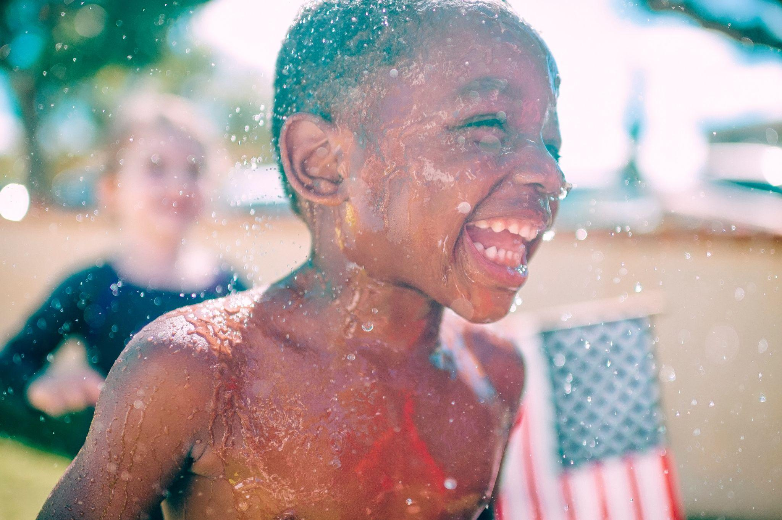
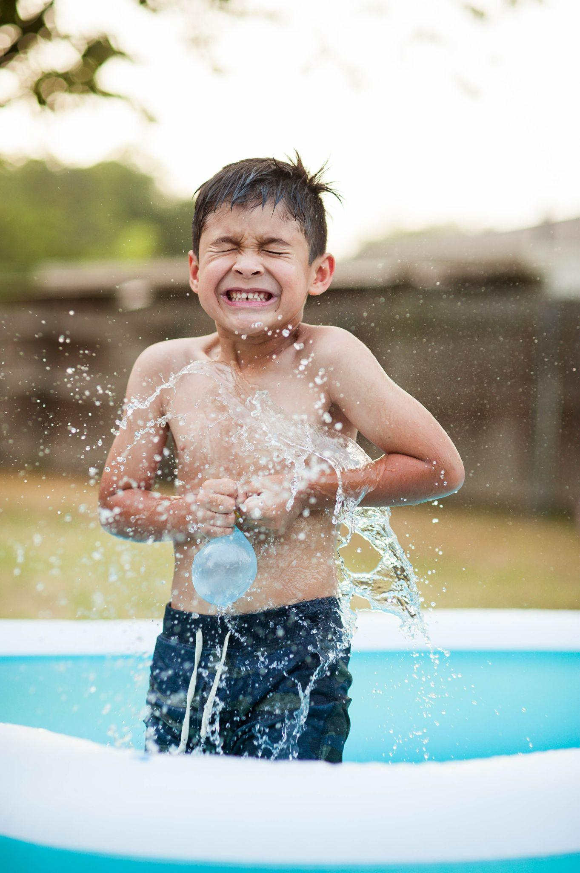
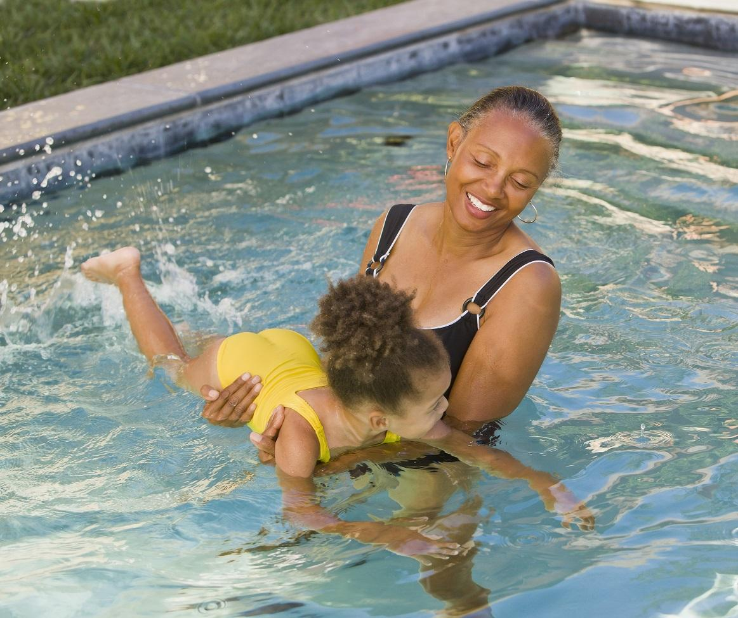
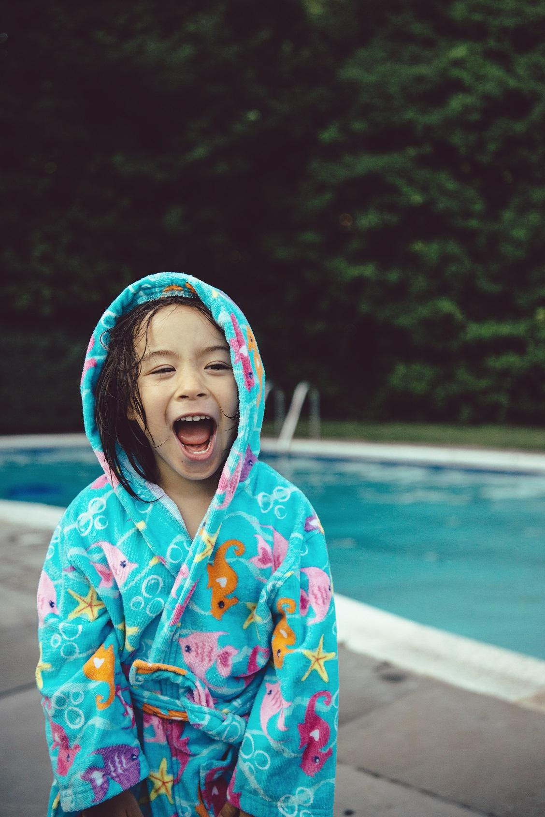
Collaborator Toolkit 2022

Slide 2
Table of Contents
Messaging……………………….……3
Grant Program………………………8
PSA……………..………………………10
Ask the Experts……………………12
Social Media……………………..…14
Visual-Logo Library…..………….22
Resources…………………………….26
Contact Information………….…32

Slide 3
MESSAGING
Pool Safely Collaborator Toolkit

Slide 4
Pool Safely Campaign Messaging
Please feel free to use these campaign messages when writing about or discussing Pool Safely:
Pool Safely is a national public education campaign from the U.S. Consumer Product Safety Commission (CPSC).
Drowning is the number one cause of unintentional death among children ages 1-4. According to CPSC data released in June 2022, on average, 389 children drown in pools and spas annually.
Drownings happen quickly and often they are silent. It’s not like in the movies, where children are portrayed as splashing and yelling for help. Drownings are 100 percent preventable, but to prevent these tragedies, we need everyone to always follow simple water safety steps.
In particular, installing more and even stronger layers of protection is key to prevention.
One of the best layers of protection is 4-sided fencing with a self-closing, self-latching gate around all pools and spas.
We must prevent young children from being able to get near the water if an adult isn’t nearby.

Slide 5
Pool Safely Messaging – Simple Steps
Simple steps can save lives, and parents and kids should follow these additional simple safety steps:
Designate a Water Watcher: Supervision is one of the most important steps you can take to keep children safer in and around the water. Designate a Water Watcher – this is an adult, whose only job is to watch children when they’re in the pool. It’s important that the Water Watcher is not distracted by texting or phone calls.
Teach Kids to Swim: While supervision is critical, it is also important for children to learn how to swim. Kids who can’t swim face a much higher risk of drowning, so sign your children up for swimming lessons. Your local YMCA or parks and rec department are great places to go for information on swimming lessons – many even offer them for free or at a reduced cost.
Learn CPR: When your children are learning how to swim, it is important for you to learn CPR. In case of an emergency, bystander CPR can often make a real difference while you’re waiting for emergency first responders to arrive at the scene.
Check Drain Covers: Finally, regardless of whether you’re swimming in your home pool, or visiting a public pool, be sure that all drain covers are not loose or broken. Drains should be “VGB compliant,” which means they meet safety standards. If you own a pool and you’re not sure about the safety of your drain covers, a pool technician can let you know.

Slide 6
2022 Drowning Data & Messaging
In 2022, CPSC released the following data via its drowning and drain entrapment reports:
There was a slight decrease in pool-or spa-related fatal drowning incidents among children younger than 15 years old; on average, there were 389 pool- or spa-related fatal drownings reported per year for 2017 through 2019, involving children younger than 15 years of age, compared to the average of 397 per year between 2016 and 2018*
Pool- or spa-related, hospital department-treated, non-fatal drowning injuries involving children younger than 15 years of age spiked 17 percent in 2021, with 6,800 injuries reported
Seventy-three percent of the reported pool- or spa-related fatal drownings involved children younger than five years of age
On average, from 2019 – 2021, 80 percent of children treated in emergency departments for pool- or spa-related, nonfatal drowning injuries were younger than 5 years of age. Overall, 73 percent of nonfatal incidents in children under 5 that led to emergency department visits occurred at a residence, compared to nearly 27 percent that occurred in a public location. Two-thirds of reported fatal child drownings in pools or spas occurred in residential settings such as the victim’s home, the house of a family member or friend, or a neighbor’s residence.
Note: CPSC’s report addresses nonfatal drownings for the period 2019 through 2021 and fatal drownings for the period 2017 through 2019, reflecting a lag in the reporting of fatal drowning statistics.
CPSC urges families to make water safety a priority, particularly as children ages 5-14 return to community pools and summer camps, following two summers when COVID precautions kept kids away. Child drownings continue to be the leading cause of unintentional death among children ages 1 to 4 years old.

Slide 7
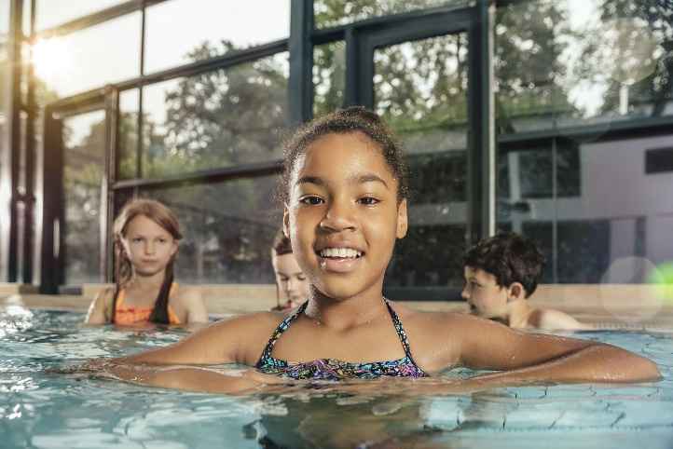
Pool Safely Messaging - Outreach
The Pool Safely campaign is reaching out to Black American and Hispanic American families via media outreach and collaborator engagement.
Research from the USA Swimming Foundation shows that 64 percent of Black American children and 45 percent of Hispanic children have no/low swimming ability.

Slide 8
Grant Program for State/Local Governments and U.S. Territories
Pool Safely Collaborator Toolkit

Slide 9
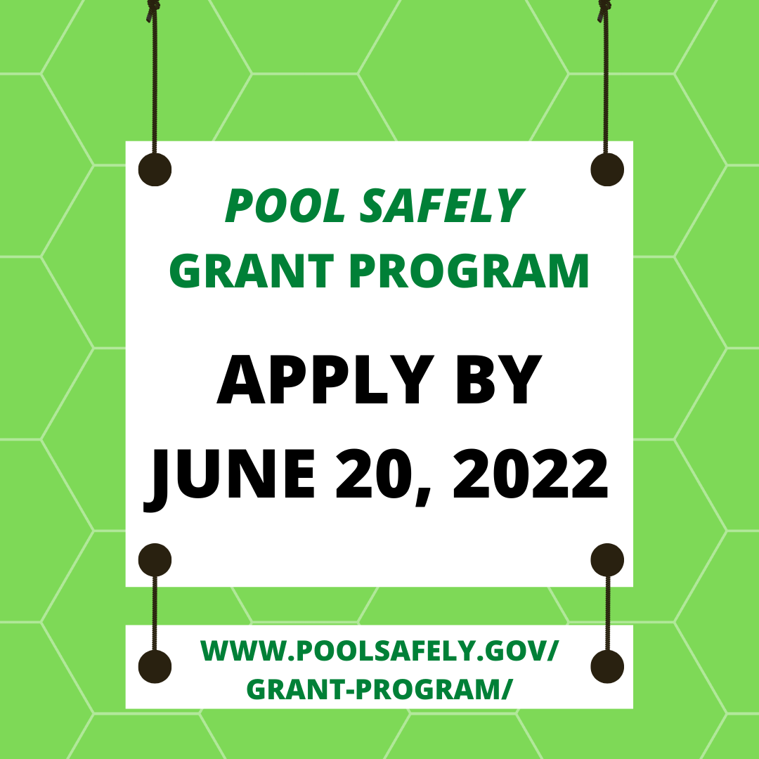
Pool Safely Grant Program
To help combat drownings, the CPSC recently announced it is seeking applications for the Pool Safely Grant Program (PSGP or grant program) to assist state and local governments with reducing deaths and injuries from drowning and drain entrapment incidents in pools and spas. CPSC will award up to a total of $2 million in two-year grants to qualifying jurisdictions, ranging from $50,000 to $400,000. The PSGP is an essential part of CPSC’s work to prevent drain entrapment and drowning.
The grant program is made possible through the Virginia Graeme Baker Pool and Spa Safety Act (VGB Act), which seeks to provide state and local governments with assistance for education, training and enforcement of pool safety requirements, as well as drowning prevention education. Since the Act’s passage in 2007, the agency has awarded nearly $5 million in funding grants to 24 recipients.
Applications are open to state or local governments or U. S. Territories through June 20, 2022. Please see www.poolsafely.gov/grant-program/ for more information and to apply.

Slide 10
Public Service Announcement
Pool Safely Collaborator Toolkit

Slide 11
PSA: Gills and Fins
What if kids were born with gills and fins? Then no parent or caregiver would ever have to worry about their safety in the water. Pool Safely recently released a new public service announcement (PSA) which imagines this very scenario.
Launched in both English and Spanish, the PSA emphasizes the fact that children do not possess built-in swimming abilities and each year, drowning is a leading cause of death for young kids. Because we can never assume children aren’t in danger while in and around water, the PSA urges parents to keep children safer by following the simple safety steps.
Watch and share the full PSA, using the links below:
English: https://bit.ly/3hUKul4
Spanish: https://bit.ly/3ckz5cU

Slide 12
ASK THE EXPERTS
Pool Safely Collaborator Toolkit

Slide 13
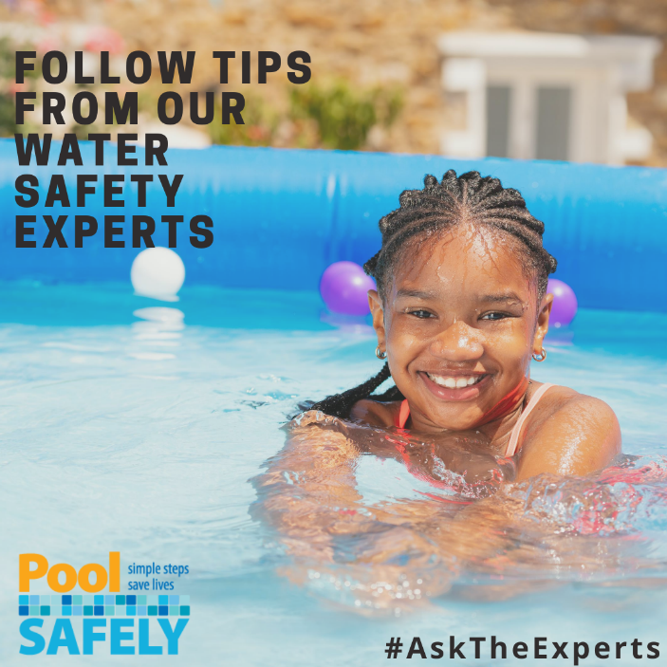
Ask the Experts
New data from CPSC’s latest submersion and entrapment report shows that drownings remain high, with two-thirds of fatal drowning incidents occurring at residential locations.
In response, Pool Safely launched the Ask the Experts video series. Collaborating with our community of drowning-prevention experts, advocates and Olympians, each video features advice about how to Pool Safely at home, or anywhere you’re spending time in or around water.
The series includes tips from U.S. Olympians such as Rowdy Gaines and Maritza McClendon, and Pool Safely collaborators such as the American Red Cross, Diversity in Aquatics, Nicole Phelps on behalf of the Michael Phelps Foundation, and the U.S. Swim School Association.
Head over to our YouTube page to watch and share the videos. If you’re interested in submitting a video of your own, email PoolSafely@cpsc.gov.

Slide 14
SOCIAL MEDIA
Pool Safely Collaborator Toolkit

Slide 15
Pool Safely Hashtags
Campaign hashtags to use when posting about Pool Safely on social media:
English:
#PoolSafely
#stopdrowning
#WaterSafety
#PoolSafely365
Spanish
#PiscinaSegura
#ComparteLaPromesa

Slide 16
Follow Pool Safely on Instagram!
Pool Safely is on Instagram! Follow and tag us @PoolSafely. Feel free to share any of the below posts on your Instagram page, using any of the images in our visual library (starting on slide 21 of this toolkit).
-Pool owners: Do you know the layers of water safety protection that can help to prevent drownings? Start by installing a four-sided, four-foot fence with a self-latching gate.
-Do you know how to select a proper life jacket for your toddler? Rule #1: Ensure it is @USCG approved.
--When was the last time you checked your hot tub drains? Make sure yours is VGB compliant to help avoid dangerous entrapments.

Slide 17
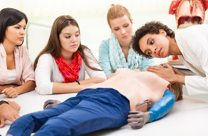
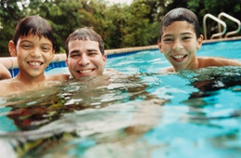
Sample Social Media Posts: Twitter
Please feel free to share any of these sample posts on your Twitter account- or write your own using these as a guide! You can also retweet us from @PoolSafely.
#DYK that performing #CPR on a drowning victim immediately after an incident can double – or even triple – their chance of survival? Everyone should learn how to perform CPR on children and adults. https://bit.ly/3blA7nY
If pools are still open in your area, you can find the #watersafety resources that match your family's needs by checking out the S.W.I.M tool from @PoolSafely: https://bit.ly/2XDYUPM

Slide 18
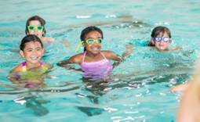
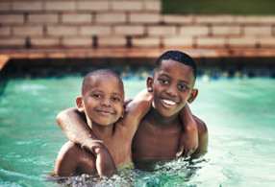
Sample Social Media Posts: Twitter
#WaterSafety shouldn't be complicated—here are 7 simple safety steps to #PoolSafely! http://bit.ly/2hHRztK
What do water skills, water smarts, and helping others have in common? They are all key components of water competency. Learn more: https://bit.ly/3En8x7R

Slide 19
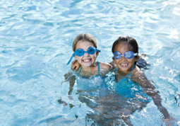
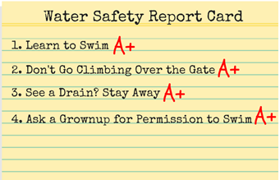
Sample Social Media Posts: Twitter
We all love to smile and have fun in the pool [insert smile face emoji] that’s why it’s important to #PoolSafely so you can be confident in the water. Start learning by reviewing our simple safety steps: https://bit.ly/3jH3VBB
If your little ones need to learn about #watersafety, the @PoolSafely song by @LaurieBerkner is a fun an easy way to teach them about the #simplesafetysteps! https://bit.ly/3cv2Jvc
Schools may be approaching holiday breaks, but there is no off season for #watersafety! Help your kids get an A+ on their water safety report cards with these free resources from #PoolSafely: https://bit.ly/3mpTkwA

Slide 20
Sample Social Media Posts: Facebook
Feel free to share any of the below posts on your Facebook page – or write your own using these as a guide! You can tag the Pool Safely Facebook page in your posts as well: @PoolSafely
The clocks fall back an hour today, but don’t fall behind on your water safety readiness! Review these four simple steps to stay safer around the water 365 days a year with the Pool Safely song by @LaurieBerknerBand: https://bit.ly/332AUWA
Teaching your kids about water safety doesn’t have to be dry—check out these fun and educational books from Pool Safely collaborators to help children learn how to stay safer in and around the water: https://bit.ly/2XNQd5w

Slide 21
Sample Social Media Posts: Spanish
Mantenerse seguro en el agua es vital. Adopta estas 7 sencillas medidas de seguridad para tener y disfrutar una #PiscinaSegura https://www.poolsafely.gov/espanol/padres/consejos-de-seguridad/
#SabíasQue Dar RCP a una víctima de ahogamiento inmediatamente después del incidente puede duplicar, incluso triplicar, sus posibilidades de sobrevivencia. Todos deberían aprender a administrar RCP a niños y adultos. https://bit.ly/3blA7nY
Enseñar a tus hijos sobre la seguridad acuática no tiene por qué ser aburrido. Con estos divertidos y educativos libros de los colaboradores de la campaña #PiscinaSeguraDiversiónAsegurada los niños pueden aprender a estar más seguros dentro y fuera del agua: https://bit.ly/2XNQd5w

Slide 22
VISUAL/ LOGO LIBRARY
Pool Safely Collaborator Toolkit

Slide 23
Visual/Logo Library
You can include any of these English/Spanish logos or images in social media posts, newsletters or on your website (Please be sure to attribute them to Pool Safely)

Slide 24
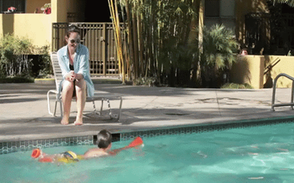
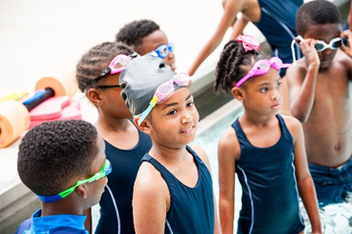
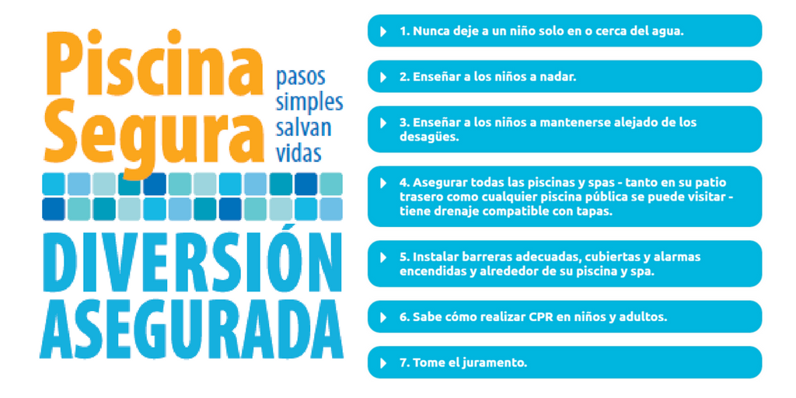
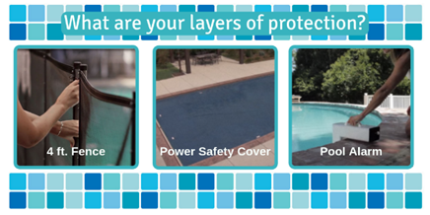
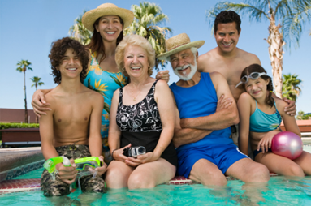
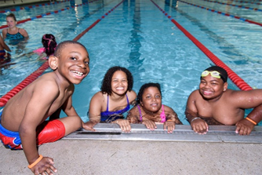

Slide 25
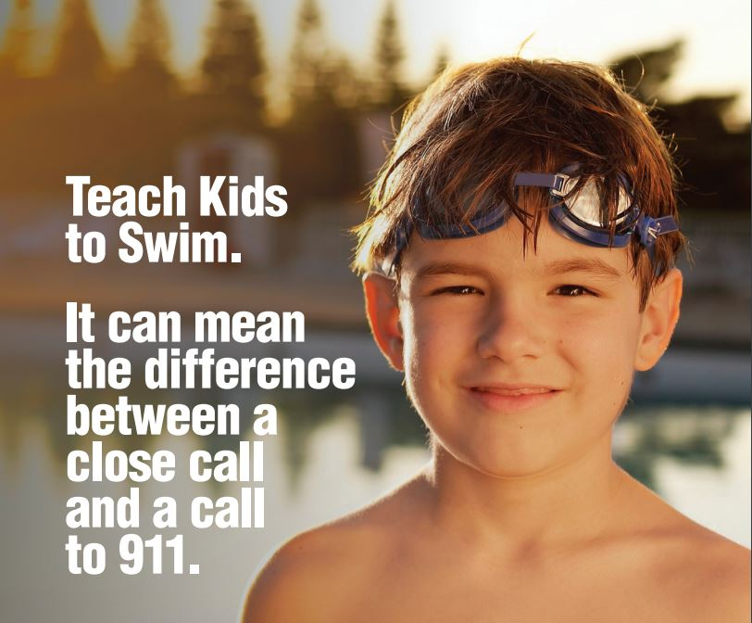
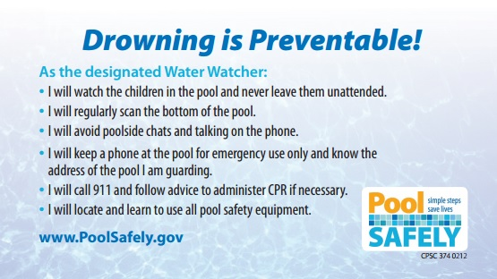
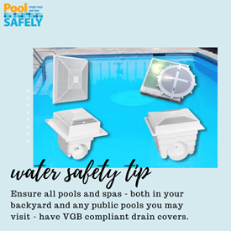
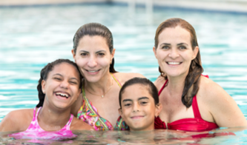
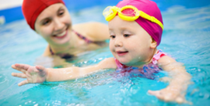

Slide 26
RESOURCES
Pool Safely Collaborator Toolkit

Slide 27
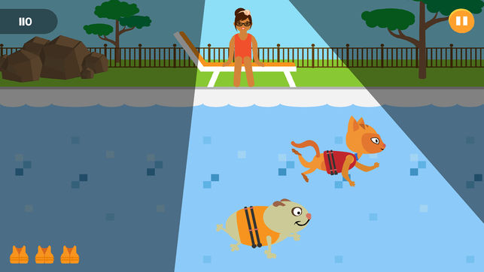
The Adventures of Splish & Splash
The Pool Safely app helps children learn about the dos and don’ts of water safety
To download the Pool Safely app on iPhone or Android: http://www.poolsafely.gov/parents/kids-corner/

Slide 28
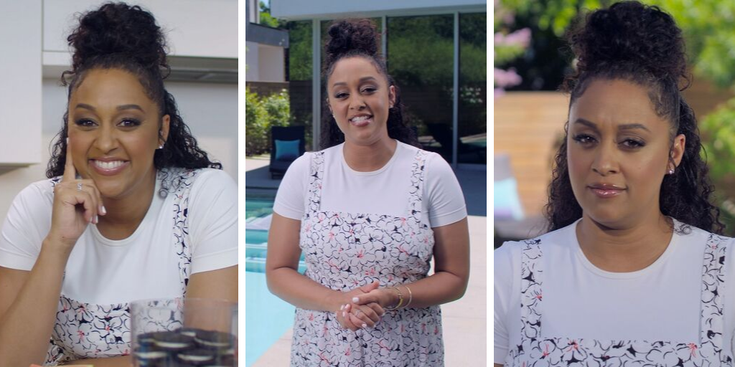
To watch a video featuring Tia Mowry sharing Pool Safely tips: https://www.poolsafely.gov/blog/behind-the-scenes-tia-mowry-urges-families-to-pool-safely-in-new-video/
Pool Safely Video with Tia Mowry

Slide 29
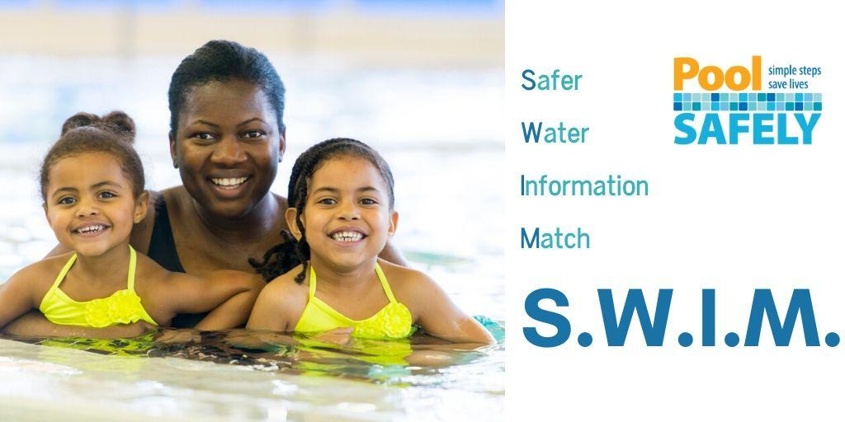
To get a list of customized water safety materials tailored to you: https://www.poolsafely.gov/blog/how-can-we-help-you-save-a-life-introducing-the-new-s-w-i-m-tool/
Safer Water Information Match (S.W.I.M.) Tool

Slide 30
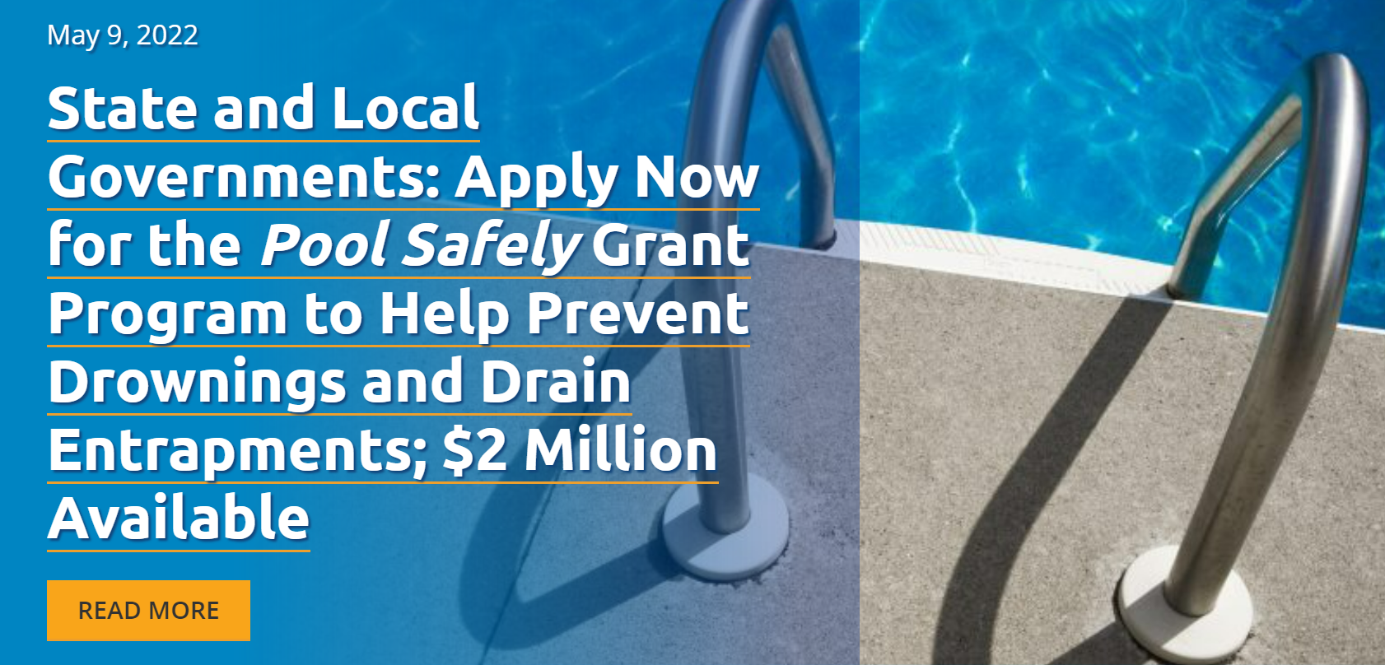
Pool Safely Blog
Check out the Pool Safely blog! https://www.poolsafely.gov/blog/
You’ll get a behind-the-scenes look at the Pool Safely campaign, learn practical safety information and stay up-to-date with the latest activities in the water safety community.

Slide 31
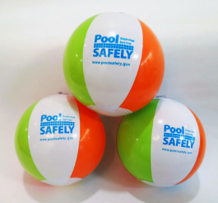
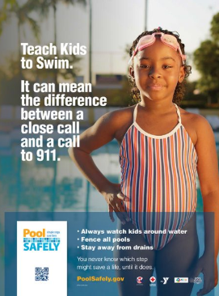
Materials Catalog
Download for no charge brochures, tip cards, posters, videos and more in English and Spanish through our online materials catalog: https://www.poolsafely.gov/educational-materials-catalog/

Slide 32
CONTACT INFORMATION
Pool Safely Collaborator Toolkit

Slide 33
Keep in touch with Pool Safely!
To follow Pool Safely on Twitter: https://twitter.com/poolsafely
To follow Pool Safely on Instagram: https://www.instagram.com/poolsafely/
To follow Pool Safely on Facebook: https://www.facebook.com/poolsafely/
To sign up for the Pool Safely email newsletter: https://www.poolsafely.gov/newsletter/?abc
To email us your questions, photos and information about your water safety events: poolsafely@cpsc.gov

