Slide 1
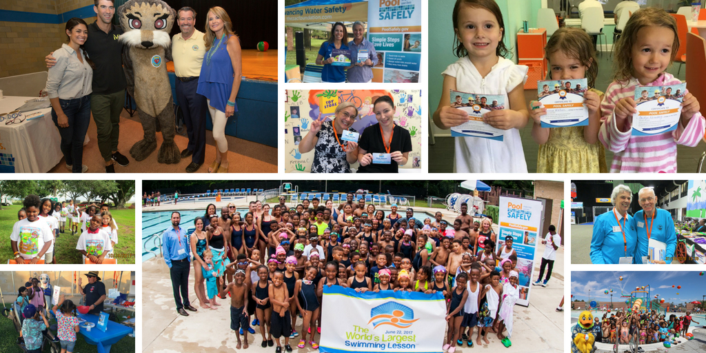
Summer 2018 Partner Toolkit

Slide 2
Table of Contents
Messaging……………………………3
Social Media…………………………10
Visuals………………………………….20
Resources…………………………….24
Contact Information…………….31

Slide 3
MESSAGING
Pool Safely Partner Toolkit

Slide 4
Pool Safely Campaign Messaging
Please feel free to use these campaign messages when writing about or discussing Pool Safely:
Pool Safely is a national public education campaign from the U.S. Consumer Product Safety Commission (CPSC).
Drowning is the number one cause of unintentional death among children ages 1-4; According to 2018 CPSC data, approximately 350 children tragically drown in pools and spas annually.
Drownings happen quickly and are often silent – It’s not like in the movies, where children are portrayed as splashing and yelling for help.
Fatal drownings are 100% preventable, but to prevent these tragedies, we need everyone to always follow simple water safety steps.
In particular, installing more and even stronger layers of protection is key to prevention.
One of the best layers of protection is 4-sided fencing with a self-closing, self-latching gate around all pools and spas.
We must prevent young children from being able to get near the water if an adult isn’t nearby.

Slide 5
Pool Safely Messaging – Simple Steps
Simple steps can save lives and parents and kids should follow these additional simple safety steps:
Designate a Water Watcher: Watch children every time they are in or around water – supervision is one of the most important things you can do to keep children safe. Designate a Water Watcher – this is an adult whose only job is to watch children when they’re in the pool. It’s important that they’re not distracted by texting or phone calls.
Teach Kids to Swim: While supervision is critical, it’s also important for children to learn how to swim. Kids who can’t swim face a much higher risk of drowning, so sign your children up for swimming lessons. Your local YMCA or parks and rec department are great places to go for information on swimming lessons – many even offer them for free or at a reduced cost.
Learn CPR: While you’re children are learning how to swim, it’s important for you to learn CPR. In the case of an emergency, bystander CPR can often make a real difference while you’re waiting for emergency first responders to arrive at the scene.
Check Drain Covers: Finally, regardless of whether you’re swimming in your home pool or visiting a public pool, be sure that the drain covers are not lose or broken. Drains should be what we call “VGB compliant,” which means they meet safety standards. If you own a pool and you’re not sure if your covers are safe, a pool technician can let you know.

Slide 6
2018 Drowning Data & Messaging
The number of reported fatal child drownings in swimming pools involving children younger than 5 has decreased 17 percent nationwide since 2010, the year that the Pool Safely campaign launched.
In 2015, the majority (76 percent) of reported fatal drowning victims younger than 15 were younger than 5.
For children younger than 15 years old, boys had twice as many fatal child drownings than girls.
For 2015 through 2017, an estimated average of 6,400 children younger than 15 years old were reported as being treated in hospital emergency rooms for non-fatal drowning injuries in pools or spas.
Between 2015 and 2017, the majority (73 percent) of children treated in emergency departments for pool- or spa-related, non-fatal drowning injuries were younger than 5 years of age.
Between 2015 and 2017, residential locations made up 74 percent of fatal reported incidents and at least 45 percent of non-fatal reported drowning incidents for children younger than 5.
From 2013 through 2017, there were 11 victims of circulation entrapments victims of entrapment in 16 incidents, with 100 percent of the incidents involving children younger than 15 years of age.
From those 11 incidents, there were two fatalities, both in residential spas.
Since the Virginia Graeme Baker Pool & Spa Safety went into effect in Dec. 2008, there have been zero entrapment-related deaths involving children in public pools and spas.

Slide 7
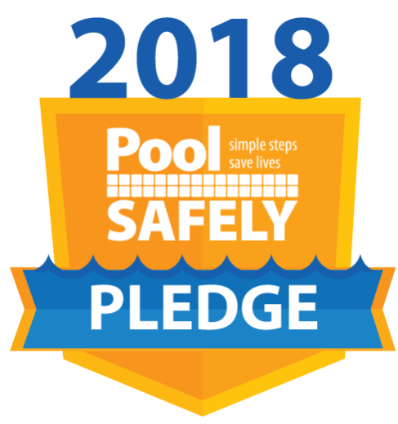
Pool Safely Messaging - Pledge
We’re asking every adult and child in America to take the Pool Safely Pledge every year.
The Pledge is a call-to-action for everyone to commit to specific steps to be safer in and around the water.
Kids will pledge to never swim alone, ask for swim lessons and stay away from drains.
Adults will pledge to always designate a water watcher, learn CPR, make their kids know how to swim, remove portable pool ladders when not in use and ensure their pools have proper fencing, gates and drain covers.
Visit PoolSafely.gov/Pledge to electronically sign the Pledge or to request a hard copy.
We have collected more than 75,000 Pool Safely Pledges from adults and kids nationwide to date, including 14 Olympians!

Slide 8
Olympian who have taken the Pledge

Slide 9
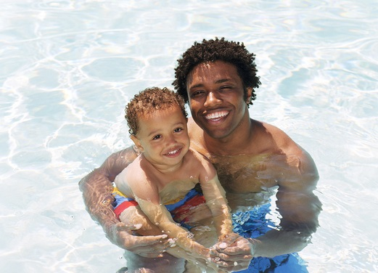
Pool Safely Messaging - Outreach
The Pool Safely campaign is reaching out to African-American and Hispanic children and their families.
Research shows that 64 percent of African American children and 45 percent of Hispanic children have no/low swimming ability.

Slide 10
SOCIAL MEDIA
Pool Safely Partner Toolkit

Slide 11
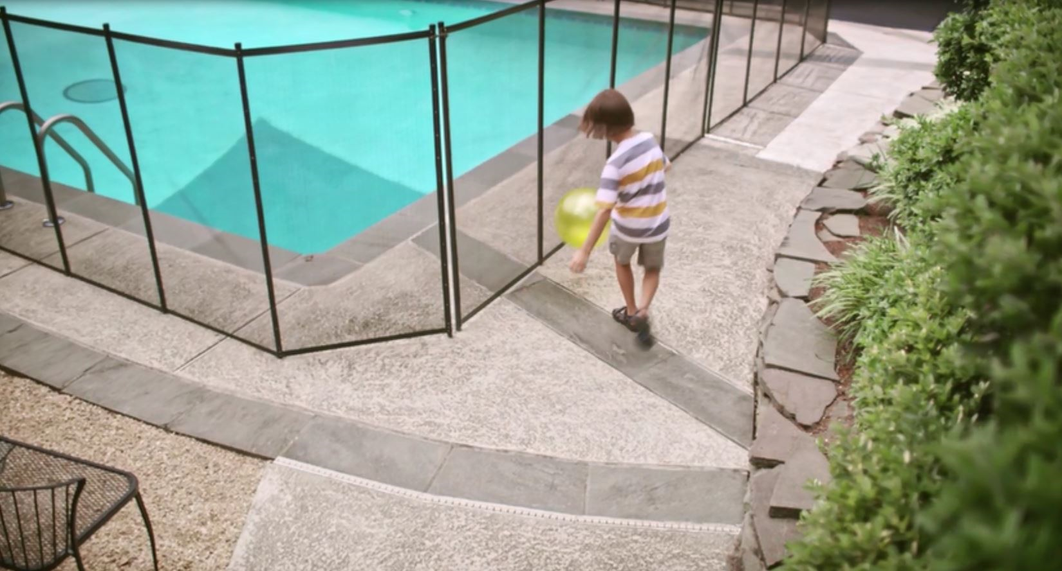
Sample Social Media Posts: Twitter
Please feel free to share any of these sample posts on your Twitter account this summer - or write your own using these as a guideline! You can also retweet us from @PoolSafely.
I took the #PoolSafely Pledge & you should too! Pledge to keep your family safer around the water this summer: http://bit.ly/PledgePS
Whether you have an in-ground, above-ground or portable pool at your home, it is critical that pool owners install layers of protection between the house and the water. http://bit.ly/2zvSa7p #SimpleSafetySteps #PoolSafely

Slide 12
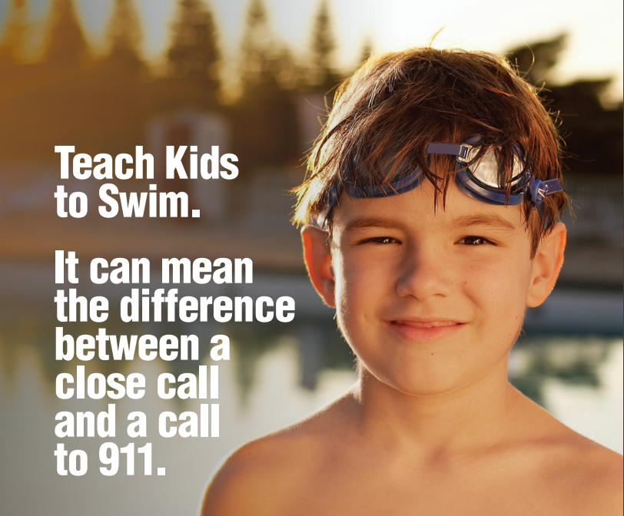
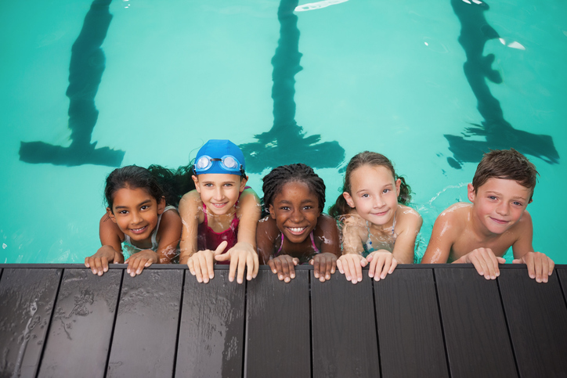
Sample Social Media Posts: Twitter
Teach kids to swim. It can be the difference between a close call & a call to 911. http://www.poolsafely.gov/ #PoolSafely
Drowning is the leading cause of unintentional death in children ages 1-4. Keep your family safer by practicing these simple #watersafety steps this summer: http://1.usa.gov/1TjMTIn

Slide 13
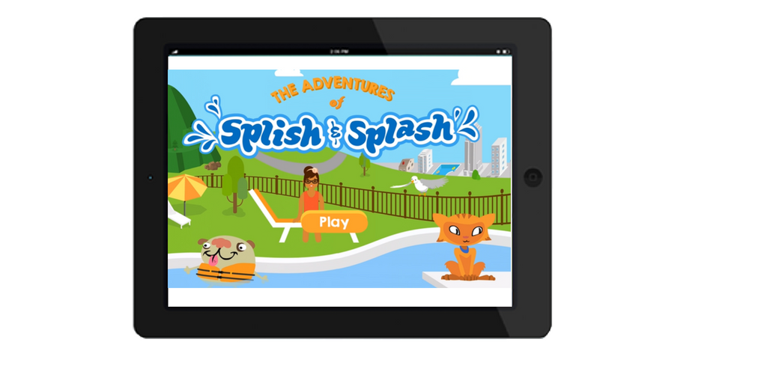
Sample Social Media Posts: Twitter
Help Splish & Splash learn how to be safer around water with the free & recently-updated #PoolSafely app for kids! http://1.usa.gov/1OE4gwa
Do you know how to #PoolSafely? Learn 4 simple steps to stay safer around the water w/ @LaurieBerkner: bit.ly/LBPoolSafely

Slide 14
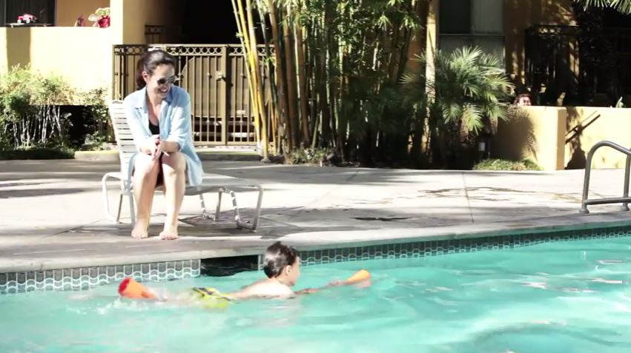
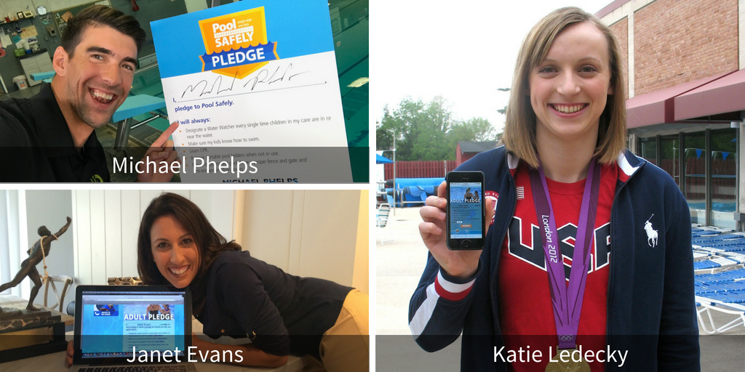
Sample Social Media Posts: Twitter
Being a #WaterWatcher means not being distracted by a phone or book. There should always be one adult with his/her full attention on kids who are in or around water: http://bit.ly/2jJL5tj #PoolSafely #stopdrowning
Act like an Olympian and take the #PoolSafely Pledge to #stopdrowning! http://bit.ly/PledgePS

Slide 15
Sample Social Media Posts: New This Year! Facebook
Feel free to share any of the below posts on your Facebook page this summer – or write your own using these as a guideline! You can tag the Pool Safely Facebook page in your posts as well: @PoolSafely
32% of injuries happen in public pools and spas. Even if your family frequents a public pool with a lifeguard, never assume that your child’s safety is guaranteed. Assign a #WaterWatcher, learn #CPR, and commit to #PoolSafely. Learn more: http://bit.ly/2hHRztK
Even if you’re not the parent of a young child doesn’t mean you shouldn’t learn how to #PoolSafely. Are you a grandparent? A babysitter? A neighbor of someone with a pool, or a pool owner with young kids nearby? If you answered yes to any of these questions, visit https://www.poolsafely.gov/ to learn valuable water safety tips.
When it comes to pool and spa-related drownings, there are no second chances. Ensuring that you learn prevention methods is the best thing you can do to keep your family safer! Learn @PoolSafely’s recommended safety steps: installing proper barriers around your residential pool. https://www.youtube.com/watch?v=H5DqxTOKHYk

Slide 16
Sample Social Media Posts: Spanish
Recuerde: Una medida de seguridad puede hacer la diferencia entre un riesgo insignificante y una llamada al 911. http://bit.ly/2gbdlWM [Remember: An extra step can mean the difference between a close call & a call to 911. http://bit.ly/2cr33B3]
Instala capas de protección alrededor de tu piscina y spa. Porque algunas cosas no se pueden rebobinar. http://bit.ly/2nlEmXP [Install layers of protection around your pool & spa. Because some things you can't rewind. http://bit.ly/2nlEmXP]
¿Tienes nietos? Mantenlos más seguros en y cerca del agua siguiendo estos pasos simples de #PiscinaSegura: http://bit.ly/2kADuQa [Do you have grandkids? Keep them safer in & around the water by following these simple #PoolSafely steps: http://bit.ly/2kADuQa]
Un niño puede ahogarse en menos tiempo que romper un récord mundial. Siempre designe un adulto observador de agua. Http://bit.ly/2nwEmDS [A child can drown in less time than it takes to break a world record. Always designate an adult Water Watcher. http://bit.ly/2nwEmDS]
Recuerde: Pasos sencillos para salvar vidas! Revise estos consejos de #PiscinaSegura antes de ir a la piscina: http://bit.ly/2kADuQa [Remember: Simple Steps Save Lives! Review these #PoolSafely tips before going to the pool with your family: http://bit.ly/2kADuQa]
Únete a las +75 mil personas que han hecho la promesa de #PiscinaSegura para prevenir incidentes cerca del agua http://bit.ly/2dv5hAb [Join more than 44K people and Pledge to be safer in & around the pool year-round! http://bit.ly/2dv5hAb]

Slide 17
Take and Share a #SafetySelfie!
We’re encouraging all partners to take and share a #SafetySelfie this summer! All you need to do is:
Take the Pool Safely Pledge at PoolSafely.gov/Pledge
Take a selfie showing that you took the Pledge (a photo with your phone, computer, or a hard copy of the Pledge)
Share the #SafetySelfie on Twitter or Facebook: I took the @PoolSafely Pledge & you should too! https://www.poolsafely.gov/pledge/
Make sure to tag @PoolSafely on social media and encourage your friends to do the same. We may feature your #SafetySelfie on social media or the blog!

Slide 18
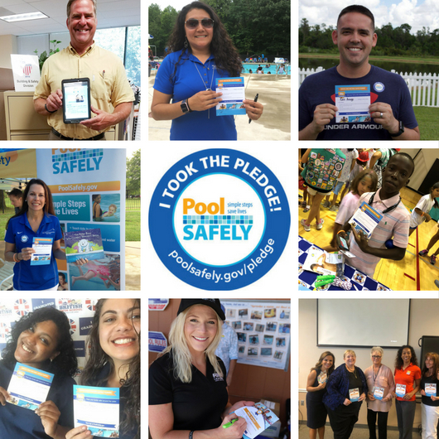
Sample Partner Safety Selfies

Slide 19
Pool Safely Hashtags
Campaign hashtags to use when posting about Pool Safely on social media:
English:
#PoolSafely
#TakethePledge
#SafetySelfie
#stopdrowning
#WaterSafety
Spanish
#PiscinaSegura

Slide 20
Visuals
Pool Safely Partner Toolkit

Slide 21
Visual/Logo Library
You can include any of these English/Spanish logos or images in social media posts, newsletters or on your website as long as you attribute them to Pool Safely.

Slide 22
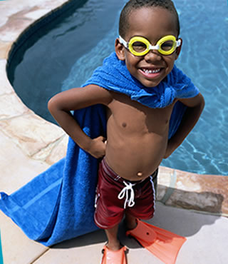
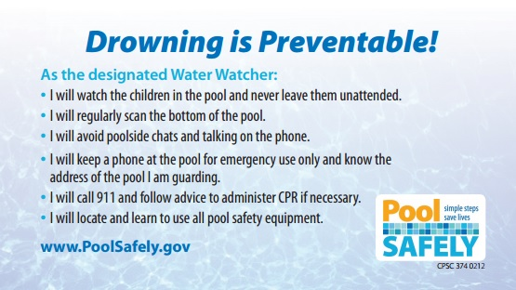
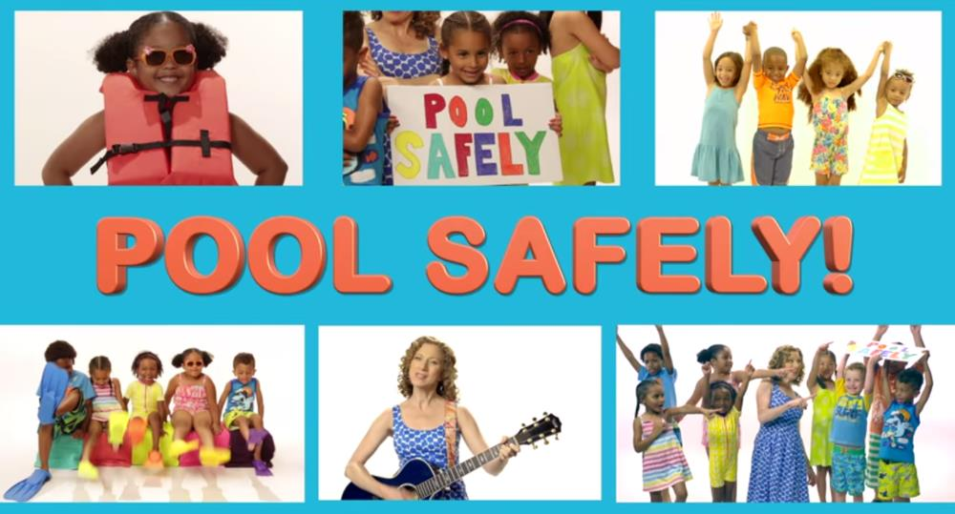
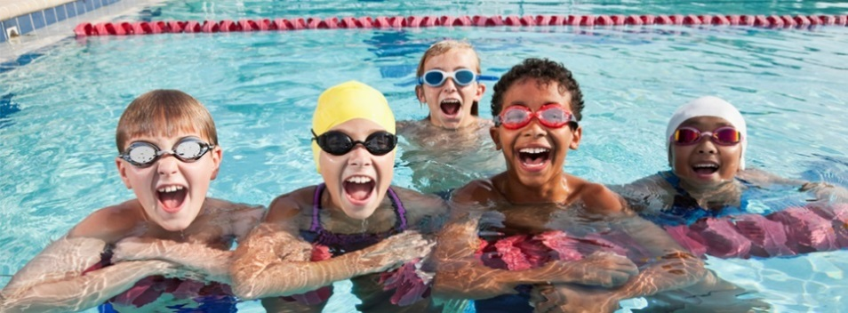
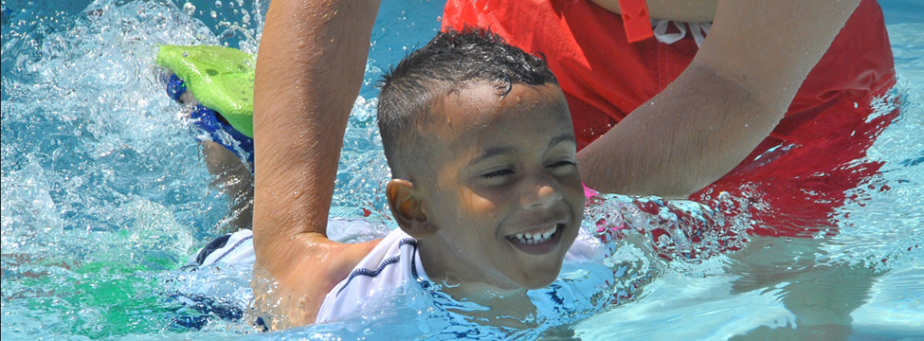

Slide 23
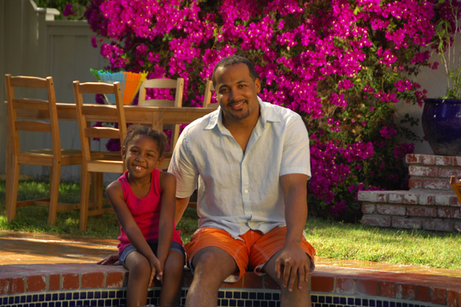
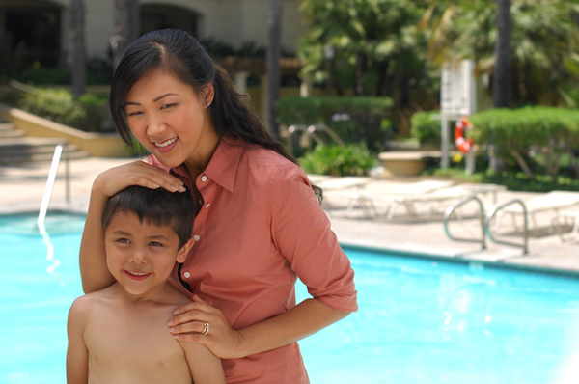
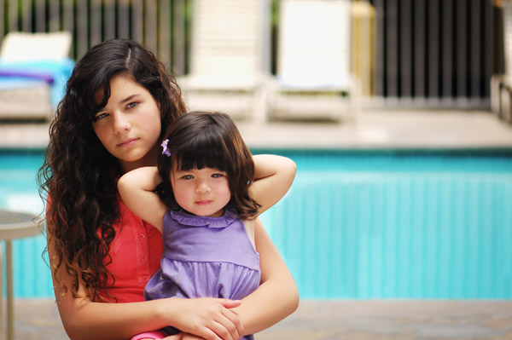
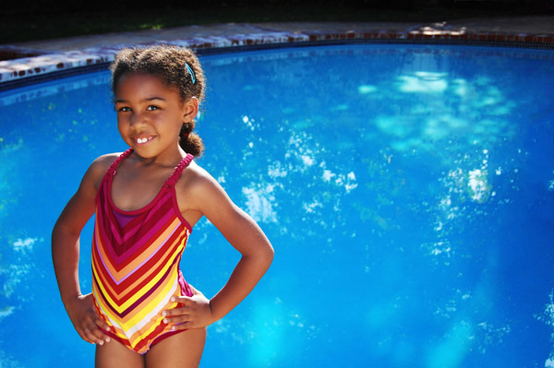

Slide 24
RESOURCES
Pool Safely Partner Toolkit

Slide 25
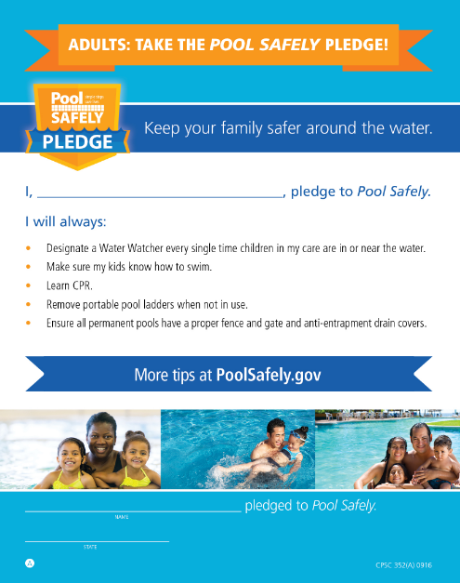
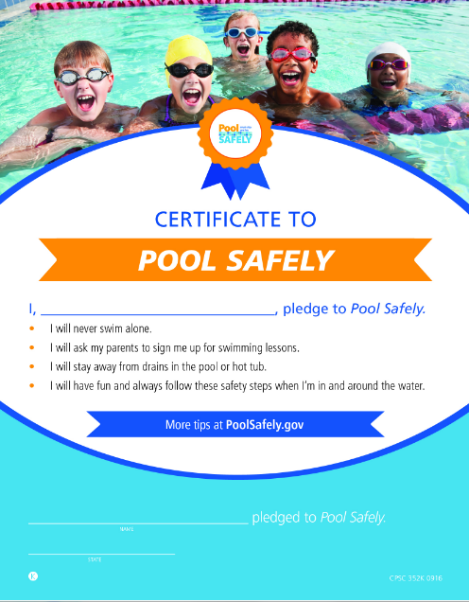
The Pool Safely Pledge
To take the Pool Safely Pledge (both kid & adult versions):
English: www.poolsafely.gov/pledge
Spanish: http://www.poolsafely.gov/promesa/

Slide 26
To watch the Pool Safely song video by Laurie Berkner: http://bit.ly/LBPSsong
The Pool Safely Song

Slide 27
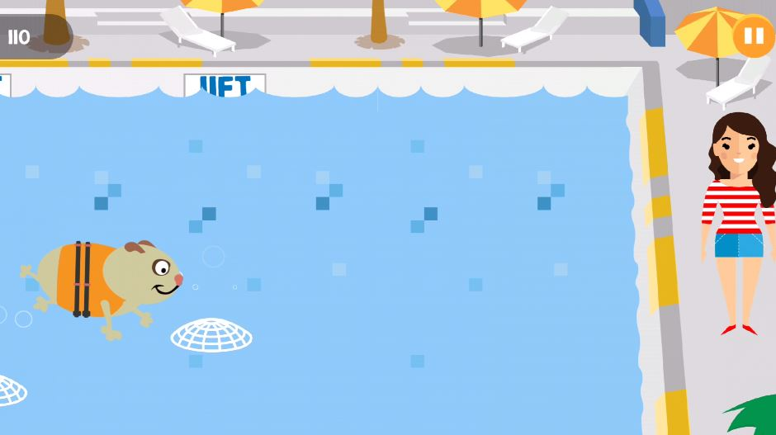
The Adventures of Splish & Splash: Updated Spring 2018
A Pool Safely app that helps children learn about the dos and don’ts of water safety
To download the Pool Safely app on iPhone or Android: http://www.poolsafely.gov/parents/kids-corner/

Slide 28
The Pool Safely Blog
Check out the Pool Safely blog! https://www.poolsafely.gov/blog/
You’ll get a behind-the-scenes look at the Pool Safely campaign, learn practical safety information and stay up-to-date with the latest activities in the water safety community.

Slide 29
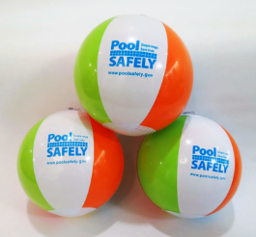
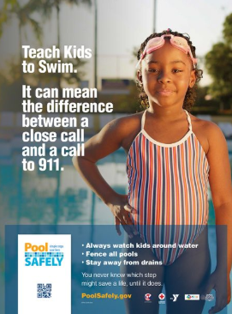
Materials Catalog
Order or download brochures, tip cards, posters, videos and more in English and Spanish through our online materials catalog: https://www.poolsafely.gov/educational-materials-catalog/

Slide 30
News & Events Page
Stay up to date with news about Pool Safely and our partners via our News & Events page: https://www.poolsafely.gov/news/
Partners are encouraged to submit your educational water safety events that you would like us to promote on this page to poolsafely@cpsc.gov. (Please note that due to government regulations, we are not able to promote fundraisers).

Slide 31
Keep in touch with Pool Safely!
To follow Pool Safely on Twitter: https://twitter.com/poolsafely
To follow Pool Safely on Facebook: https://www.facebook.com/poolsafely/
To follow Pool Safely on Flickr: https://www.flickr.com/photos/poolsafely/
To sign up for the Pool Safely email newsletter: https://www.poolsafely.gov/newsletter/?abc
To email us your questions, photos and information about your water safety events: poolsafely@cpsc.gov

