Slide 1

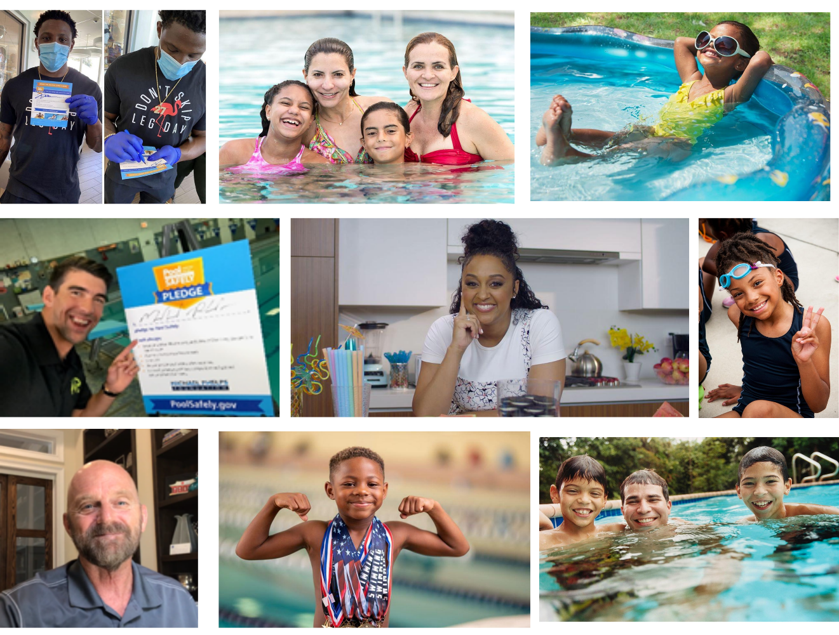
Collaborator Toolkit 2020

Slide 2
Table of Contents
Messaging……………………………3
New PSA……………..……………….26
Ask the Experts……………………10
Social Media……………………..…12
Visual-Logo Library…..………….22
Resources…………………………….28
Contact Information………….…35

Slide 3
MESSAGING
Pool Safely Collaborator Toolkit

Slide 4
Pool Safely Campaign Messaging
Please feel free to use these campaign messages when writing about or discussing Pool Safely:
Pool Safely is a national public education campaign from the U.S. Consumer Product Safety Commission (CPSC).
Drowning is the number one cause of unintentional death among children ages 1-4. According to CPSC data released in June 2020, on average, 379 children drown in pools and spas annually.
Drownings happen quickly and often they are silent. It’s not like in the movies, where children are portrayed as splashing and yelling for help. Drownings are 100 percent preventable, but to prevent these tragedies, we need everyone to always follow simple water safety steps.
In particular, installing more and even stronger layers of protection is key to prevention.
One of the best layers of protection is 4-sided fencing with a self-closing, self-latching gate around all pools and spas.
We must prevent young children from being able to get near the water if an adult isn’t nearby.

Slide 5
Pool Safely Messaging – Simple Steps
Simple steps can save lives, and parents and kids should follow these additional simple safety steps:
Designate a Water Watcher: Supervision is one of the most important steps you can take to keep children safer in and around the water. Designate a Water Watcher – this is an adult, whose only job is to watch children when they’re in the pool. It’s important that the Water Watcher is not distracted by texting or phone calls.
Teach Kids to Swim: While supervision is critical, it is also important for children to learn how to swim. Kids who can’t swim face a much higher risk of drowning, so sign your children up for swimming lessons. Your local YMCA or parks and rec department are great places to go for information on swimming lessons – many even offer them for free or at a reduced cost.
Learn CPR: When your children are learning how to swim, it is important for you to learn CPR. In case of an emergency, bystander CPR can often make a real difference while you’re waiting for emergency first responders to arrive at the scene.
Check Drain Covers: Finally, regardless of whether you’re swimming in your home pool, or visiting a public pool, be sure that all drain covers are not loose or broken. Drains should be “VGB compliant,” which means they meet safety standards. If you own a pool and you’re not sure about the safety of your drain covers, a pool technician can let you know.

Slide 6
2020 Drowning Data & Messaging
In 2020, CPSC released the following data via its drowning and drain entrapment reports:
For 2017 through 2019, an estimated average of 6,700 children younger than 15 years old were reportedly treated in hospital emergency rooms for non-fatal drowning injuries in pools or spas.
Between 2017 and 2019, the majority (76 percent) of children treated in emergency departments for pool- or spa-related, non-fatal drowning injuries were younger than 5 years of age.
Between 2017 and 2019, residential settings made up 71 percent of fatal reported incidents and at least 42 percent of non-fatal reported drowning incidents for children younger than 5.
Between 2017 and 2019, the majority (74 percent) of reported fatal drowning victims younger than 15 were younger than 5.
For children younger than 15 years old, boys had twice as many fatal child drownings as girls.
From 2014 through 2018, there were 11 victims of circulation entrapments in 11 incidents, with 100 percent of the incidents involving children younger than 15 years of age.
From those 11 incidents, there were two fatalities, both in residential spas.
Since the VGB Act went into effect in Dec. 2008, there have been zero entrapment-related deaths involving children in public pools and spas.
Note: CPSC’s report addresses nonfatal drownings for the period 2017 through 2019 and fatal drownings for the period 2015 through 2017, reflecting a lag in the reporting of fatal drowning statistics.

Slide 7
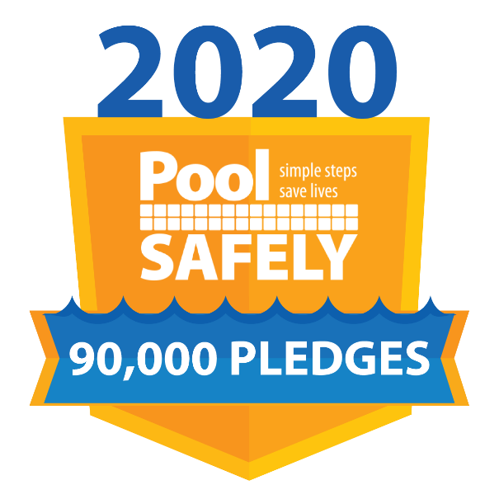
Pool Safely Messaging - Pledge
We’re asking every adult and child in America to take the Pool Safely Pledge every year.
The Pledge is a call-to-action for everyone to commit to specific steps to be safer in and around the water.
Kids will pledge never to swim alone, will ask for swim lessons and will stay away from drains.
Adults will pledge to always designate a water watcher, learn CPR, make sure their kids know how to swim, remove portable pool ladders when not in use and ensure their pools have proper fencing, gates and safe drain covers.
Visit PoolSafely.gov/Pledge to electronically sign the Pledge or to request a hard copy.
We have collected more than 90,000 Pool Safely Pledges from adults and kids nationwide to date, including 15 Olympians!

Slide 8
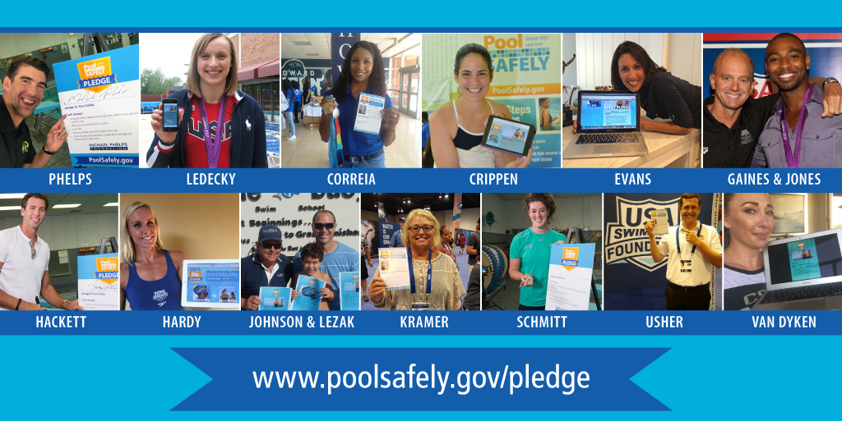
Olympians who have taken the Pledge

Slide 9
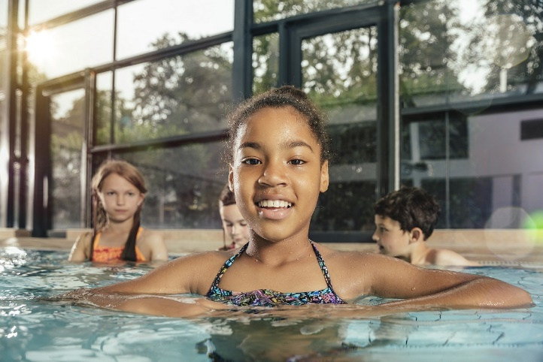
Pool Safely Messaging - Outreach
The Pool Safely campaign is reaching out to African American and Hispanic children and their families.
Research shows that 64 percent of African American children and 45 percent of Hispanic children have no/low swimming ability.

Slide 10
New PSA
Pool Safely Collaborator Toolkit

Slide 11
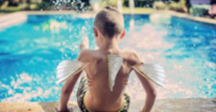

New PSA: Gills and Fins
What if kids were born with gills and fins? Then no parent or caregiver would ever have to worry about their safety in the water. Pool Safely recently released a new public service announcement (PSA) which imagines this very scenario.
Launched in both English and Spanish, the PSA emphasizes the fact that children do not possess built-in swimming abilities and each year, drowning is a leading cause of death for young kids. Because we can never assume children aren’t in danger while in and around water, the PSA urges parents to keep children safer by following the simple safety steps.
Watch and share the full PSA, using the links below:
English: https://bit.ly/3hUKul4
Spanish: https://bit.ly/3ckz5cU

Slide 12
Ask the experts
Pool Safely Collaborator Toolkit

Slide 13
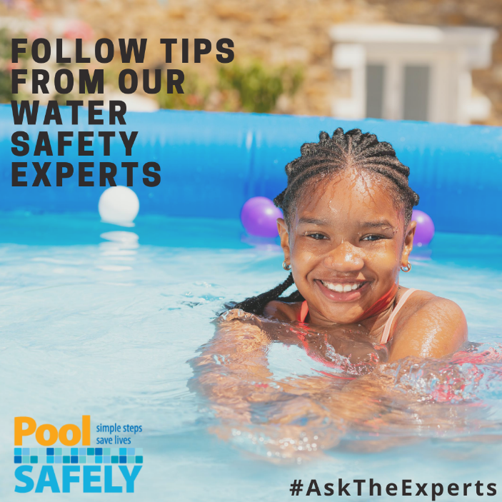
Ask the Experts
New data from CPSC’s latest submersion and entrapment report shows that drownings are on the rise, with 71 percent of fatal drowning incidents occurring at residential locations.
In response, Pool Safely launched the Ask the Experts video series. Collaborating with our community of drowning-prevention experts, advocates and Olympians, each video features advice about how to Pool Safely at home, or anywhere you’re spending time in or around water.
The series includes tips from U.S. Olympians such as Rowdy Gaines and Maritza McClendon, and Pool Safely collaborators such as the American Red Cross, Diversity in Aquatics, Nicole Phelps on behalf of the Michael Phelps Foundation, and the U.S. Swim School Association.
Head over to our YouTube page to watch and share the videos. If you’re interested in submitting a video of your own, email PoolSafely@cpsc.gov.

Slide 14
SOCIAL MEDIA
Pool Safely Collaborator Toolkit

Slide 15
Pool Safely Hashtags
Campaign hashtags to use when posting about Pool Safely on social media:
English:
#PoolSafely
#TakethePledge
#SafetySelfie
#stopdrowning
#WaterSafety
PoolSafely365
#PledgeItOn
Spanish
#PiscinaSegura
#ComparteLaPromesa

Slide 16


Follow Pool Safely on Instagram!
Pool Safely is now on Instagram! Follow and tag us @PoolSafely. Feel free to share any of the below posts on your Instagram page, using any of the images in our visual library (starting on slide 24 of this toolkit).
-If your kids are home and you have a residential pool or spa, make sure you have the proper #layersofprotection including alarms, covers and gates. Learn more by visiting PoolSafely.gov.
-Even if you’re not a parent, you should still learn how to #PoolSafely. Are you a grandparent? A babysitter? A neighbor of someone with a pool, or a pool owner with young kids nearby? If you answered yes to any of these questions, visit PoolSafely.gov to learn valuable water safety tips.
-When it comes to pool and spa-related drownings, there are no second chances. Ensuring that you learn prevention methods is the best thing you can do to keep your family safer! Visit PoolSafely.gov to learn more.

Slide 17
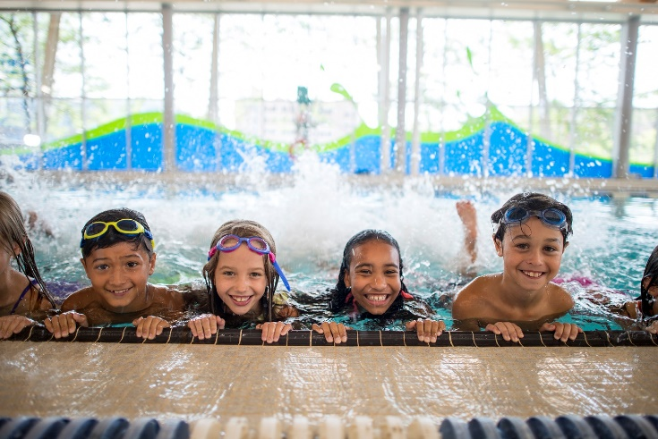
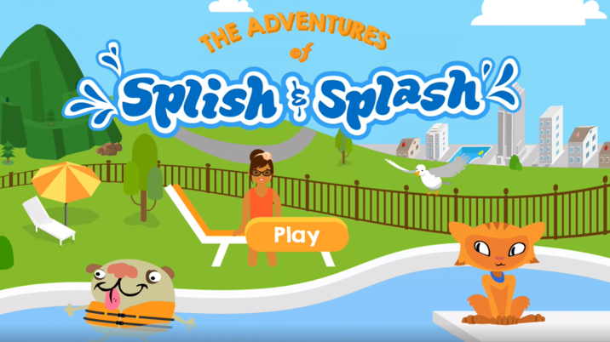
Sample Social Media Posts: Twitter
Please feel free to share any of these sample posts on your Twitter account- or write your own using these as a guide! You can also retweet us from @PoolSafely.
Do you have what it takes to be a designated #WaterWatcher? Learn about the requirements and use your best water watching skills every time your kids are in or around the water: http://bit.ly/2jJL5tj
While spending time at home, kids can learn about #layersofprotection, #waterwatchers and more by playing the Adventures of Splish and Splash! Learn more from @PoolSafely: http://bit.ly/2FLMm1f

Slide 18
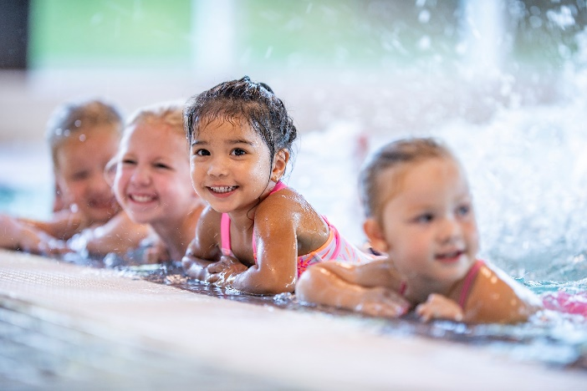
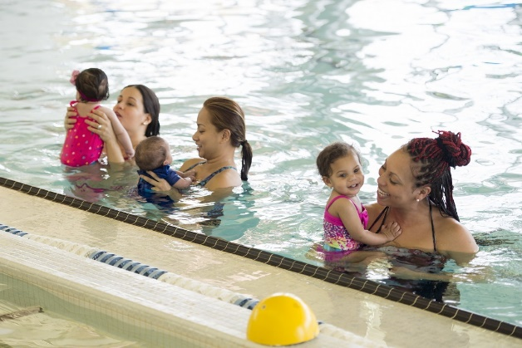
Sample Social Media Posts: Twitter
Teach kids to swim. It can be the difference between a close call and a call to 911. http://bit.ly/2nKM8ej #PoolSafely
Drowning is the leading cause of unintentional death in children ages 1-4. Keep your family safer by practicing these simple #watersafety steps: http://bit.ly/2hHRztK

Slide 19
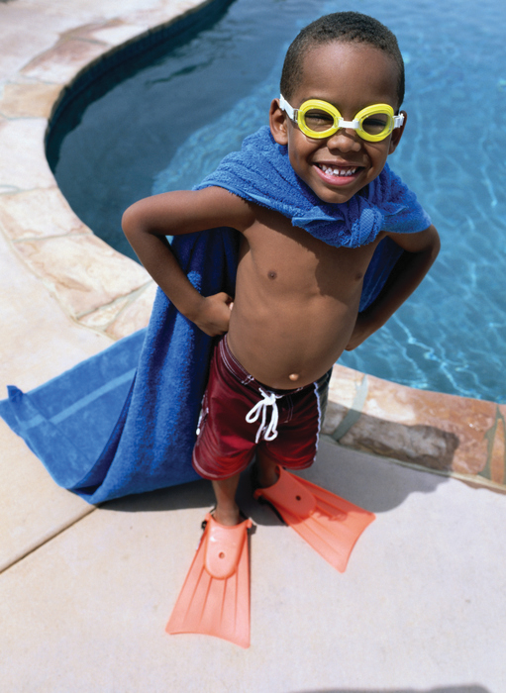

Sample Social Media Posts: Twitter
Are you looking for fun indoor activities for your kids while everyone is spending more time at home? The @PoolSafely kids' corner is full of ideas! Learn more: Bit.ly/2hTLEj8
If your little ones need to learn about #watersafety, the @PoolSafely song by @LaurieBerkner is a fun an easy way to teach them about the #simplesafetysteps! https://bit.ly/3cv2Jvc
A drowning incident can occur faster than the time it takes you to read this tweet. Every second counts. Spend a few of yours taking the #PoolSafelyPledge: http://bit.ly/PledgePS

Slide 20
Sample Social Media Posts: Facebook
Feel free to share any of the below posts on your Facebook page – or write your own using these as a guide! You can tag the Pool Safely Facebook page in your posts as well: @PoolSafely
As social distancing restrictions loosen in many places around the country, kids' playdates may start back up as well. If your kids will be at a home with a pool or spa, make sure you ask these questions before dropping them off: https://bit.ly/3bkYu51
Putting down our phones is difficult when staying connected with loved ones from home, but always put them away when children are in or around water. Drowning is quick and silent. Learn more: bit.ly/2jJL5tj

Slide 21
Sample Social Media Posts: Spanish
Lo mejor que pueden hacer los padres y cualquier persona que cuida a niños cuando estos están en o cerca del agua es mantenerlos lejos de los desagües. Recuérdale a todos los niños: cuando veas un desagüe, ¡mantente lejos! http://bit.ly/2jR4Scu [One of the best things parents and caregivers can do to keep kids safer in or around water is to ensure they stay away from drains. Remind all kids: when you see a drain, stay away! http://bit.ly/2jR4Scu]
¿Estás familiarizado con las medidas de seguridad de #PiscinaSeguraDiversiónAsegurada para hacer las piscinas más seguras? Instalar barreras, cuberturas/tapas y alarmas adecuadas es una medida muy importante para la #SeguridadAcuática: https://bit.ly/2m0Pid3 [Are you familiar with the layers of protection that make for safer swimming pools? Installing proper barriers, covers and alarms are an important #safetystep: https://bit.ly/2m0Pid3]
74 % de las muertes por ahogamiento en niños ocurren en residencias. Pon al día tus habilidades de #VigilanteDelAgua para tener una temporada de #PiscinaSeguraDiversiónAsegurada todo el año): http://bit.ly/2jJL5tj [74% of child drowning deaths happen at a residence? Brush up on you #WaterWatcher skills today so you’ll be ready to #PoolSafely all year long: http://bit.ly/2jJL5tj]

Slide 22
Take and Share a #SafetySelfie!
We’re encouraging all collaborators to take and share a #SafetySelfie via your social media channels! All you need to do is:
Take the Pool Safely Pledge at PoolSafely.gov/Pledge
Take a selfie showing that you took the Pledge (a photo with your phone, computer or a hard copy of the Pledge)
Share the #SafetySelfie on Twitter or Facebook: I took the @PoolSafely Pledge & you should too! https://www.poolsafely.gov/pledge/
Make sure to tag @PoolSafely on social media and encourage your friends to do the same. We may feature your #SafetySelfie on social media or on the Pool Safely blog!

Slide 23
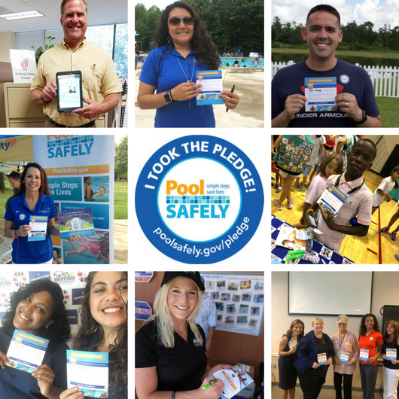
Sample Collaborator Safety Selfies

Slide 24
Visual/ Logo Library
Pool Safely Collaborator Toolkit

Slide 25

Visual/Logo Library
You can include any of these English/Spanish logos or images in social media posts, newsletters or on your website (Please be sure to attribute them to Pool Safely)

Slide 26

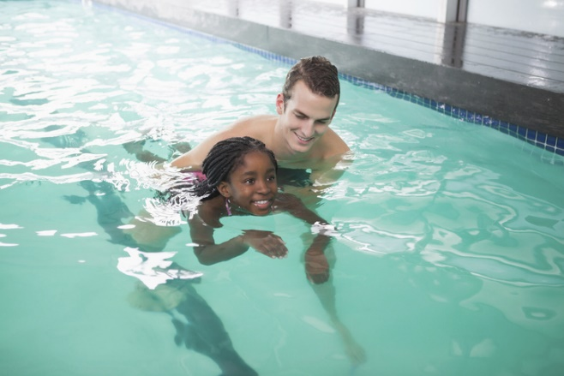
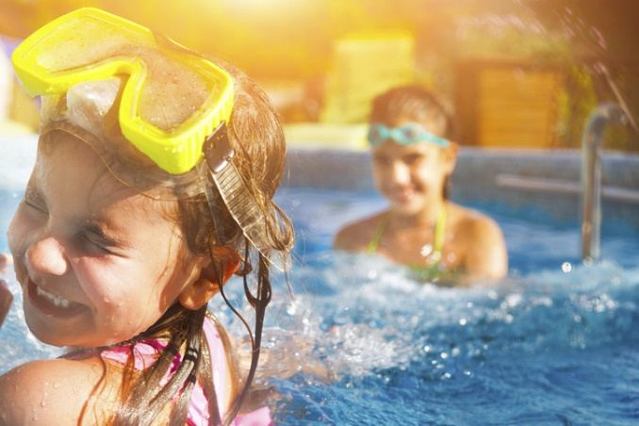
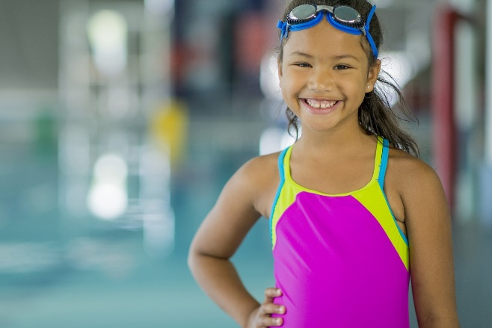
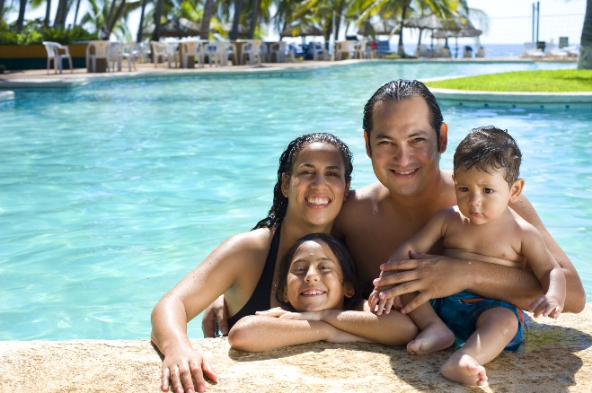
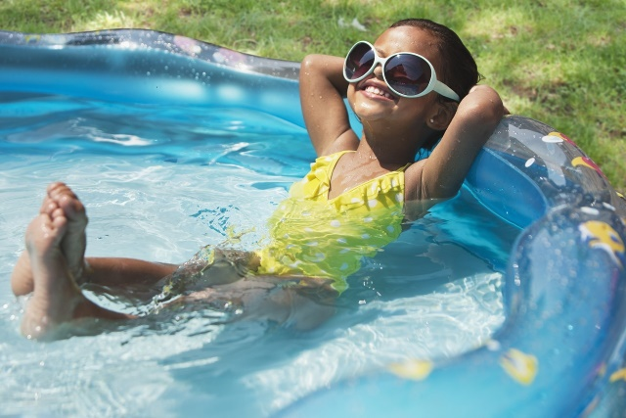
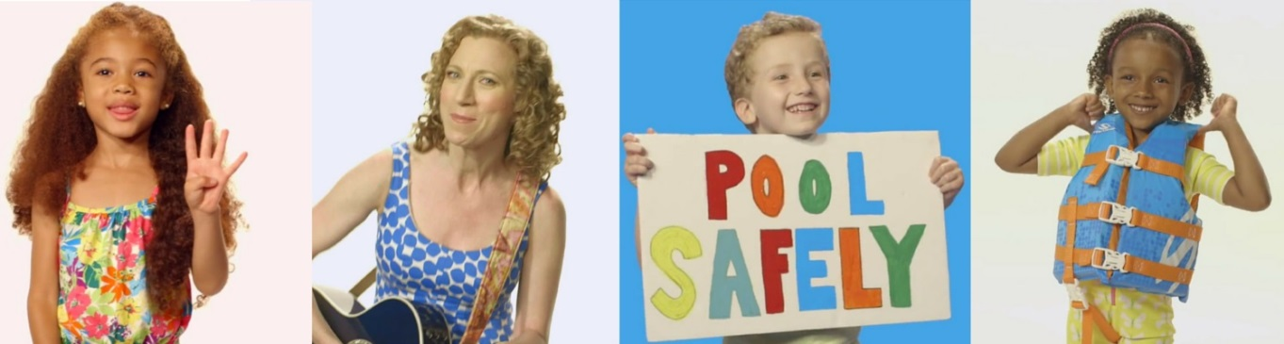

Slide 27
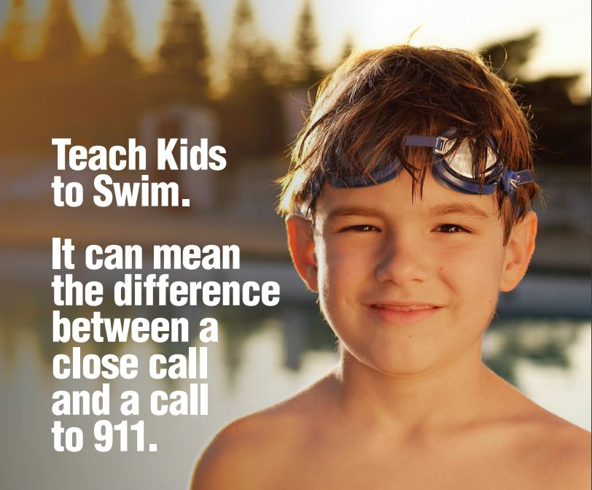
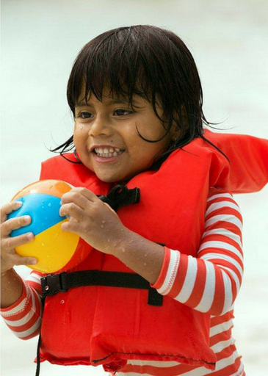
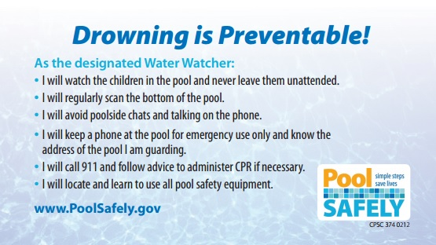

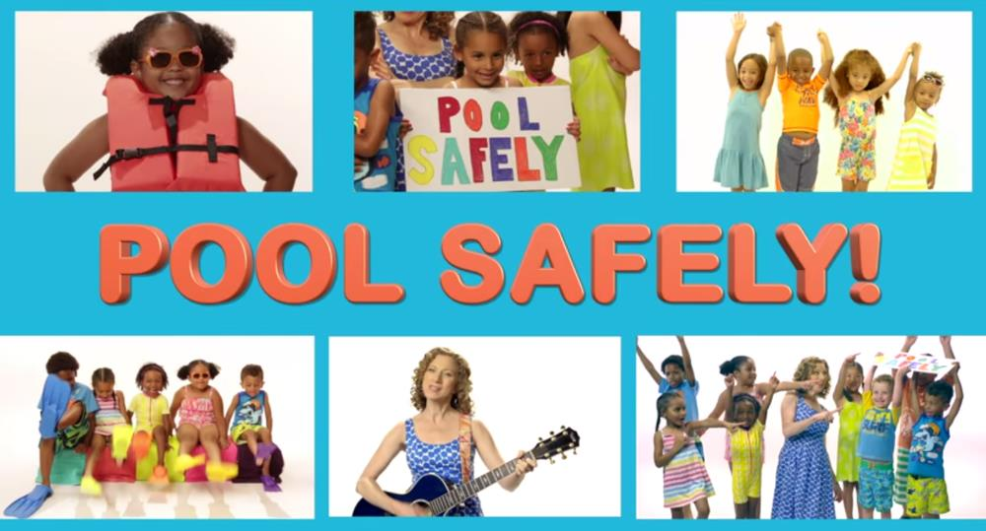
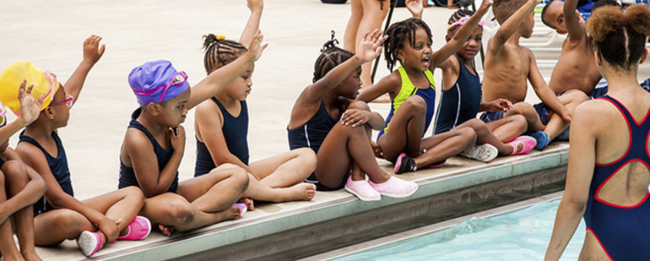
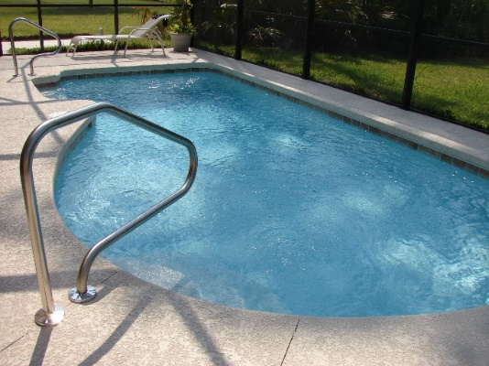
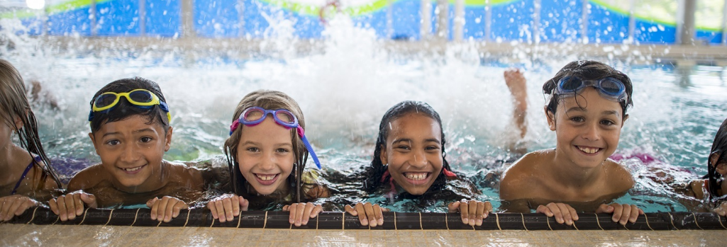

Slide 28
RESOURCES
Pool Safely Collaborator Toolkit

Slide 29
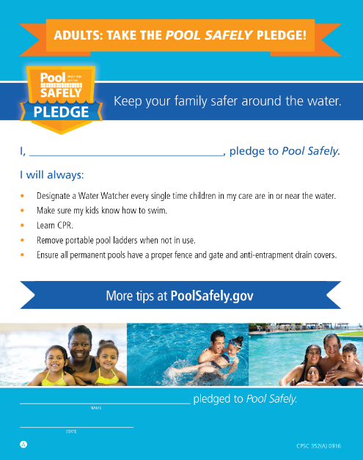
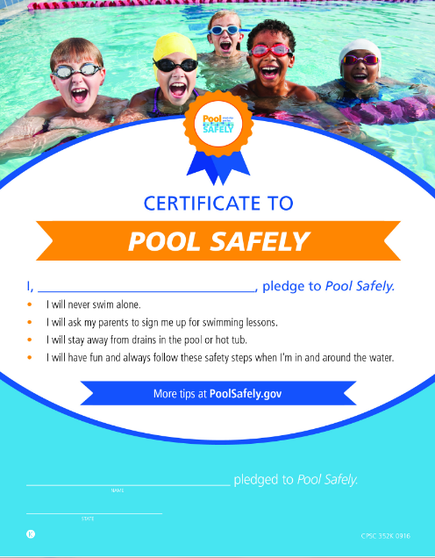
The Pool Safely Pledge
To take the Pool Safely Pledge (both child & adult versions):
English: www.poolsafely.gov/pledge
Spanish: http://www.poolsafely.gov/promesa/

Slide 30

To watch the Pool Safely song video by Laurie Berkner: http://bit.ly/LBPSsong
The Pool Safely Song

Slide 31

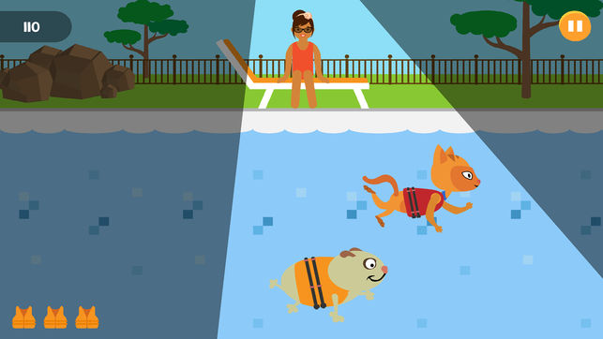
The Adventures of Splish & Splash
The Pool Safely app helps children learn about the dos and don’ts of water safety
To download the Pool Safely app on iPhone or Android: http://www.poolsafely.gov/parents/kids-corner/

Slide 32
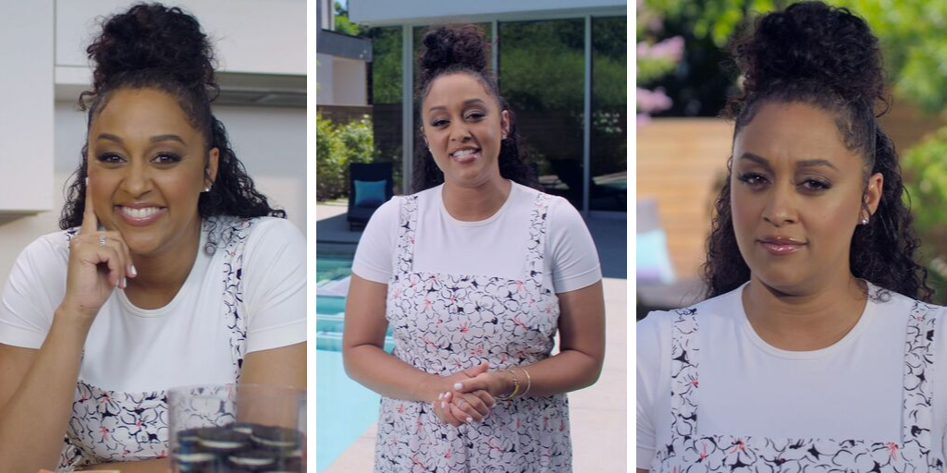
To watch a video featuring Tia Mowry sharing Pool Safely tips: https://www.poolsafely.gov/blog/behind-the-scenes-tia-mowry-urges-families-to-pool-safely-in-new-video/
Pool Safely Video with Tia Mowry

Slide 33
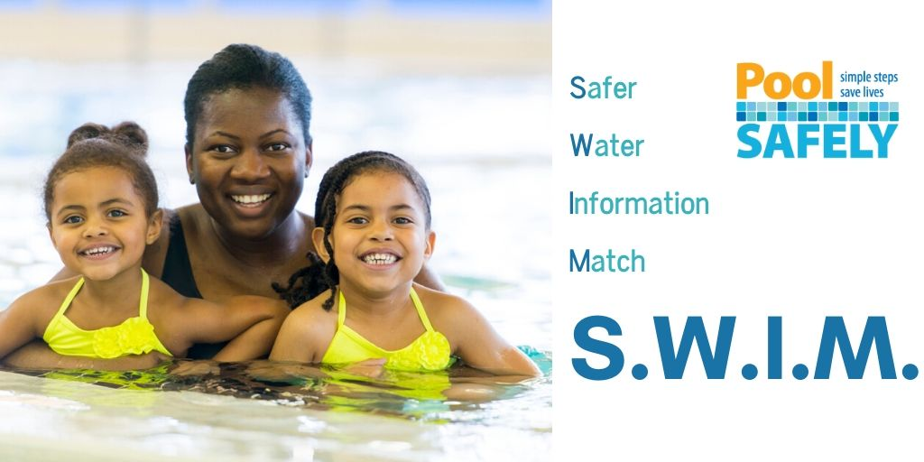
To get a list of customized water safety materials tailored to you: https://www.poolsafely.gov/blog/how-can-we-help-you-save-a-life-introducing-the-new-s-w-i-m-tool/
Safer Water Information Match (S.W.I.M.) Tool

Slide 34
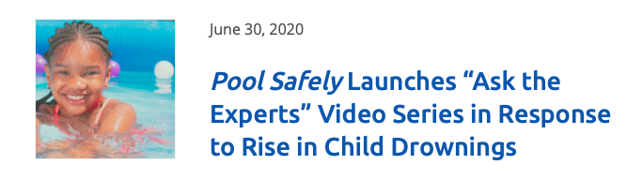


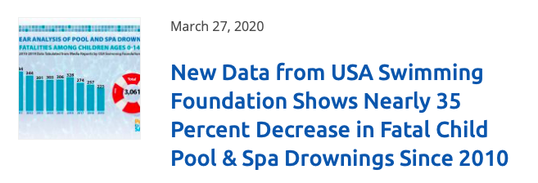
Pool Safely Blog
Check out the Pool Safely blog! https://www.poolsafely.gov/blog/
You’ll get a behind-the-scenes look at the Pool Safely campaign, learn practical safety information and stay up-to-date with the latest activities in the water safety community.

Slide 35

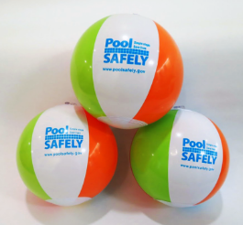
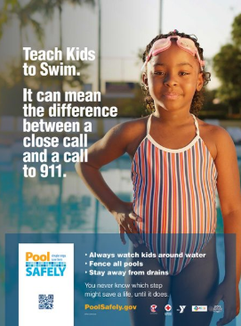

Materials Catalog
Download brochures, tip cards, posters, videos and more in English and Spanish through our online materials catalog: https://www.poolsafely.gov/educational-materials-catalog/

Slide 36
Contact information
Pool Safely Collaborator Toolkit

Slide 37
Keep in touch with Pool Safely!
To follow Pool Safely on Twitter: https://twitter.com/poolsafely
To follow Pool Safely on Instagram: https://www.instagram.com/poolsafely/
To follow Pool Safely on Facebook: https://www.facebook.com/poolsafely/
To sign up for the Pool Safely email newsletter: https://www.poolsafely.gov/newsletter/?abc
To email us your questions, photos and information about your water safety events: poolsafely@cpsc.gov

