Slide 1

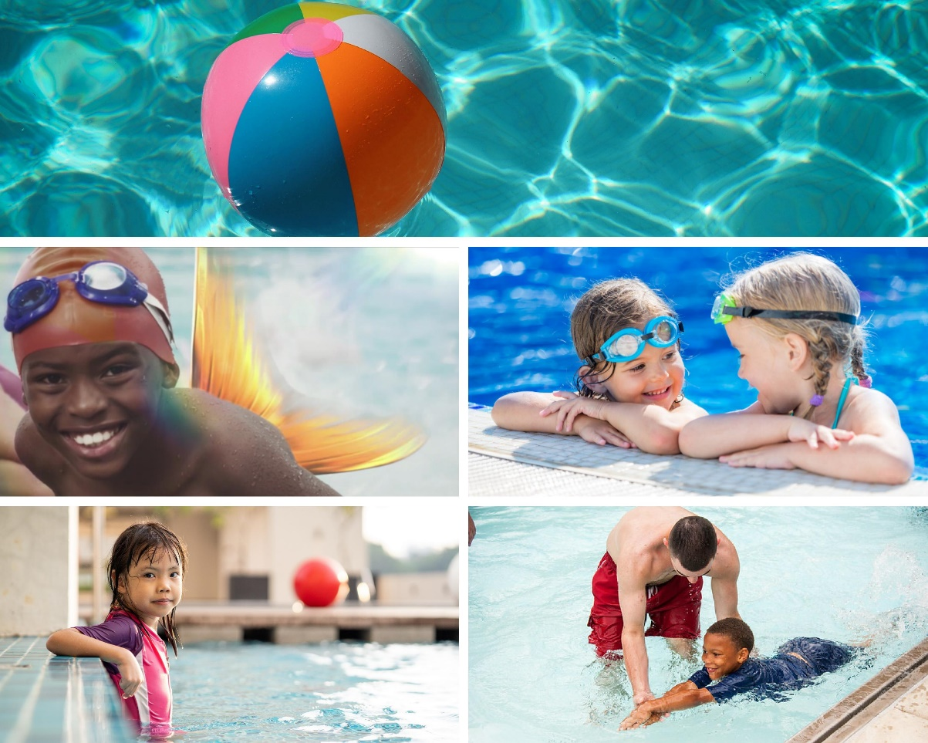
Collaborator Toolkit
2021

Slide 2
Table of Contents
Messaging……………………………3
New PSA……………..……………….8
Ask the Experts……………………10
Social Media……………………..…12
Visual-Logo Library…..………….21
Resources…………………………….25
Contact Information………….…32

Slide 3
MESSAGING
Pool Safely Collaborator Toolkit

Slide 4
Pool Safely Campaign Messaging
Please feel free to use these campaign messages when writing about or discussing Pool Safely:
  Pool Safely is a national public education campaign from the U.S. Consumer Product Safety Commission (CPSC).
  Drowning is the number one cause of unintentional death among children ages 1-4. According to CPSC data released in June 2021, on average, there were 397 reported pool-or-spa-related fatal drownings involving children younger than 15 years of age per year from 2016 through 2018.
  Drownings happen quickly and often they are silent. It’s not like in the movies, where children are portrayed as splashing and yelling for help. Drownings are 100 percent preventable, but to prevent these tragedies, we need everyone to always follow simple water safety steps.
  In particular, installing more and even stronger layers of protection is key to prevention.
  One of the best layers of protection is 4-sided fencing with a self-closing, self-latching gate around all pools and spas.
  We must prevent young children from being able to get near the water if an adult isn’t nearby.

Slide 5
Pool Safely Messaging – Simple Steps
Simple steps can save lives, and parents and kids should follow these additional simple safety steps:
  Designate a Water Watcher: Supervision is one of the most important steps you can take to keep children safer in and around the water. Designate a Water Watcher – this is an adult, whose only job is to watch children when they’re in the pool. It’s important that the Water Watcher is not distracted by texting or phone calls.
  Teach Kids to Swim: While supervision is critical, it is also important for children to learn how to swim. Kids who can’t swim face a much higher risk of drowning, so sign your children up for swimming lessons. Your local YMCA or parks and rec department are great places to go for information on swimming lessons – many even offer them for free or at a reduced cost.
  Learn CPR: When your children are learning how to swim, it is important for you to learn CPR. In case of an emergency, bystander CPR can often make a real difference while you’re waiting for emergency first responders to arrive at the scene.
  Check Drain Covers: Finally, regardless of whether you’re swimming in your home pool, or visiting a public pool, be sure that all drain covers are not loose or broken. Drains should be “VGB compliant,” which means they meet safety standards. If you own a pool and you’re not sure about the safety of your drain covers, a pool technician can let you know.

Slide 6
2021 Drowning Data & Messaging
In 2021, CPSC released the following data via its drowning and drain entrapment reports:
  Child drownings remain the leading cause of unintentional death among children ages one to four years old.
  There was an increase in pool-or spa-related fatal drowning incidents among children younger than 15 years old.
  On average, there were 397 reported pool-or-spa-related fatal drownings involving children younger than 15 years of age per year from 2016 through 2018.
  Seventy-five percent of the reported fatal drownings from 2016 through 2018 involved children younger than five years of age—eighty-three percent of these were at residential pools.
  From 2018 to 2020, 78 percent of nonfatal drowning injuries occurred among children younger than five years old.
  While the report shows the number of pool-or spa-related nonfatal drowning injuries treated by hospital emergency departments decreased from 2019 (6,300 injuries) to 2020 (5,800 injuries), CPSC advises that the changes are not statistically significant and is likely the result of limitations on summer activities due to the COVID-19 pandemic.
  Since the VGB Act went into effect in Dec. 2008, there have been zero entrapment-related deaths involving children in public pools and spas.
    Note: CPSC’s report addresses nonfatal drownings for the period 2017 through 2019 and fatal drownings for the period 2015 through 2017, reflecting a lag in the reporting of fatal drowning statistics.

Slide 7
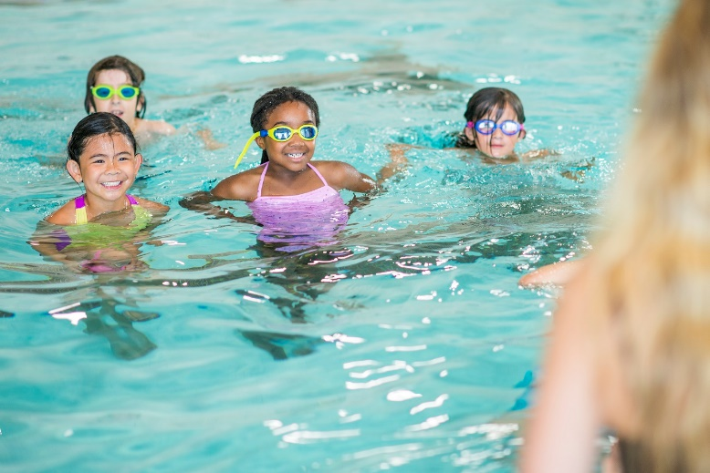
Pool Safely Messaging - Outreach
The Pool Safely campaign is reaching out to African American and Hispanic children and their families.
  Research shows that 64 percent of African American children and 45 percent of Hispanic children have no/low swimming ability.

Slide 8
NEW PSA
Pool Safely Collaborator Toolkit

Slide 9


New PSA: Gills and Fins
What if kids were born with gills and fins? Then no parent or caregiver would ever have to worry about their safety in the water. Pool Safely recently released a new public service announcement (PSA) which imagines this very scenario.
Launched in both English and Spanish, the PSA emphasizes the fact that children do not possess built-in swimming abilities and each year, drowning is a leading cause of death for young kids. Because we can never assume children aren’t in danger while in and around water, the PSA urges parents to keep children safer by following the simple safety steps.
Watch and share the full PSA, using the links below:
English: https://bit.ly/3hUKul4
Spanish: https://bit.ly/3ckz5cU

Slide 10
ASK THE EXPERTS and Pool Safely STORIES
Pool Safely Collaborator Toolkit

Slide 11
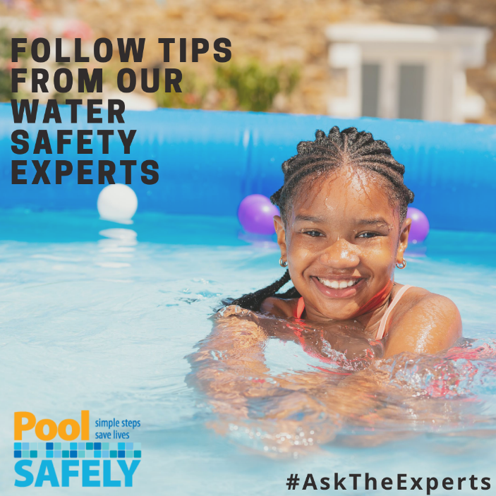
Ask the Experts
New data from CPSC’s 2020 submersion and entrapment report shows that drownings are on the rise, with 71 percent of fatal drowning incidents occurring at residential locations.
In response, Pool Safely launched the Ask the Experts video series. Collaborating with our community of drowning-prevention experts, advocates and Olympians, each video features advice about how to Pool Safely at home, or anywhere you’re spending time in or around water.
The series includes tips from U.S. Olympians such as Rowdy Gaines and Maritza McClendon, and Pool Safely collaborators such as the American Red Cross, Diversity in Aquatics, Nicole Phelps on behalf of the Michael Phelps Foundation, and the U.S. Swim School Association.
Head over to our YouTube page to watch and share the videos. If you’re interested in submitting a video of your own, email PoolSafely@cpsc.gov.

Slide 12
Pool Safely Stories
Pool Safely is creating a database of personal stories related to drowning prevention and water safety from families and organizations, which we’re calling Pool Safely Stories. These stories will help to contextualize data and water safety tips in a way that resonates better with audiences, especially the parents and caregivers we all want to reach with critical safety messages.
We are inviting all interested collaborators to submit their stories for inclusion in the database, which will be available via the campaign’s online press kit and shared on an individual basis with interested reporters.
If you are interested in submitting your story for inclusion in the Pool Safely Stories media database, please email poolsafely@finnpartners.com. See example stories from collaborators here.

Slide 13
SOCIAL MEDIA
Pool Safely Collaborator Toolkit

Slide 14
Pool Safely Hashtags
Campaign hashtags to use when posting about Pool Safely on social media:
  English:
    #PoolSafely
    #TakethePledge
    #SafetySelfie
    #stopdrowning
    #WaterSafety
    PoolSafely365
    #PledgeItOn
  Spanish
    #PiscinaSegura
    #ComparteLaPromesa

Slide 15


Follow Pool Safely on Instagram!
Pool Safely is on Instagram! Follow and tag us @PoolSafely. Feel free to share any of the below posts on your Instagram page, using any of the images in our visual library (starting on slide 24 of this toolkit).
-If your kids are home and you have a residential pool or spa, make sure you have the proper #layersofprotection including alarms, covers, and gates. Learn more by visiting PoolSafely.gov.
-Even if you’re not a parent, you should still learn how to #PoolSafely. Are you a grandparent? A babysitter? A neighbor of someone with a pool, or a pool owner with young kids nearby? If you answered yes to any of these questions, visit PoolSafely.gov to learn valuable water safety tips.
-When it comes to pool and spa-related drownings, there are no second chances. Ensuring that you learn #drowningprevention methods is the best thing you can do to keep your family safer! Visit PoolSafely.gov to learn more.

Slide 16
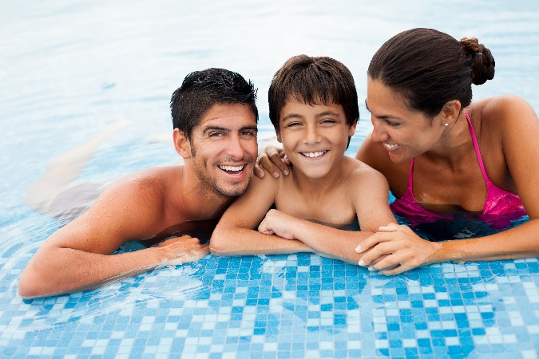
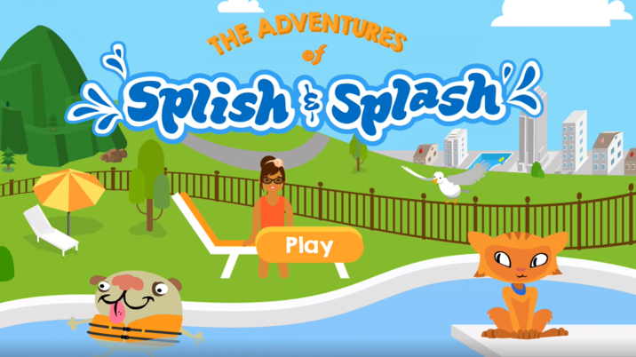
Sample Social Media Posts: Twitter
Please feel free to share any of these sample posts on your Twitter account- or write your own using these as a guide! You can also retweet us from @PoolSafely.
  Do you have what it takes to be a designated #WaterWatcher? Learn about the requirements and use your best water watching skills every time kids are in or around the water: http://bit.ly/2jJL5tj
  #DYK that kids can learn about #layersofprotection, #waterwatchers and more by playing the Adventures of Splish and Splash? Read more from @PoolSafely: http://bit.ly/2FLMm1f

Slide 17
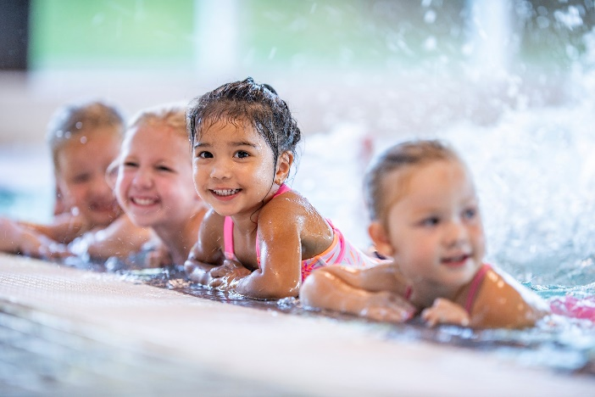
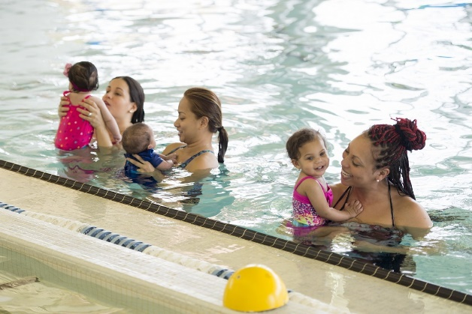
Sample Social Media Posts: Twitter
  Teach kids to swim. It can be the difference between a close call and a call to 911. http://bit.ly/2nKM8ej #PoolSafely
  Drowning is the leading cause of unintentional death in children ages 1-4. Keep your family safer by practicing these simple #watersafety steps: http://bit.ly/2hHRztK

Slide 18
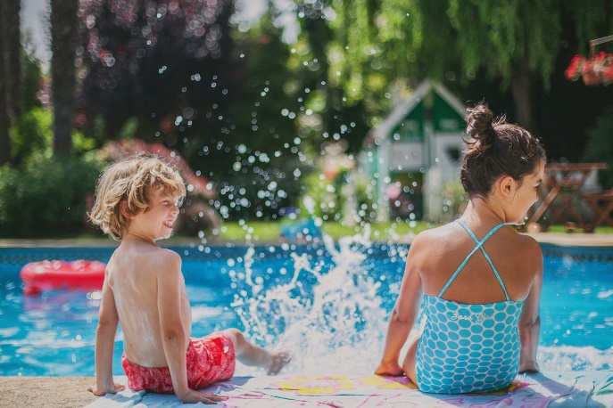
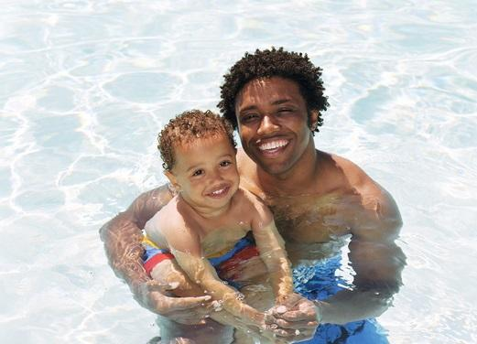
Sample Social Media Posts: Twitter
  If your little ones need to learn about #watersafety, the @PoolSafely song by @LaurieBerkner is a fun an easy way to teach them about the #simplesafetysteps! https://bit.ly/3cv2Jvc
  A drowning incident can occur faster than the time it takes you to read this tweet. Every second counts. Spend a few of yours reviewing @PoolSafely’s simple safety steps: http://bit.ly/2hHRztK

Slide 19
Sample Social Media Posts: Facebook
Feel free to share any of the below posts on your Facebook page – or write your own using these as a guide! You can tag the Pool Safely Facebook page in your posts as well: @PoolSafely
  As kids gear up for summer break, playdates will quickly fill up family calendars! If your kids visit a home with a pool or spa, make sure you ask these questions before dropping them off: https://bit.ly/3bkYu51
  Putting down our phones is difficult during the busy summertime, but always put them away when children are in or around water. Drowning is quick and silent. Learn more: https://bit.ly/2jJL5tj

Slide 20
Sample Social Media Posts: Spanish
  Lo mejor que pueden hacer los padres y cualquier persona que cuida a niños cuando estos están en o cerca del agua es mantenerlos lejos de los desagües. Recuérdale a todos los niños: cuando veas un desagüe, ¡mantente lejos! http://bit.ly/2jR4Scu [One of the best things parents and caregivers can do to keep kids safer in or around water is to ensure they stay away from drains. Remind all kids: when you see a drain, stay away! http://bit.ly/2jR4Scu]
  ¿Estás familiarizado con las medidas de seguridad de #PiscinaSeguraDiversiónAsegurada para hacer las piscinas más seguras? Instalar barreras, cuberturas/tapas y alarmas adecuadas es una medida muy importante para la #SeguridadAcuática: https://bit.ly/2m0Pid3 [Are you familiar with the layers of protection that make for safer swimming pools? Installing proper barriers, covers and alarms are an important #safetystep: https://bit.ly/2m0Pid3]
  74 % de las muertes por ahogamiento en niños ocurren en residencias. Pon al día tus habilidades de #VigilanteDelAgua para tener una temporada de #PiscinaSeguraDiversiónAsegurada todo el año): http://bit.ly/2jJL5tj [74% of child drowning deaths happen at a residence? Brush up on you #WaterWatcher skills today so you’ll be ready to #PoolSafely all year long: http://bit.ly/2jJL5tj]

Slide 21
VISUAL/ LOGO LIBRARY
Pool Safely Collaborator Toolkit

Slide 22


Visual/Logo Library
You can include any of these English/Spanish logos or images in social media posts, newsletters or on your website (Please be sure to attribute them to Pool Safely)

Slide 23
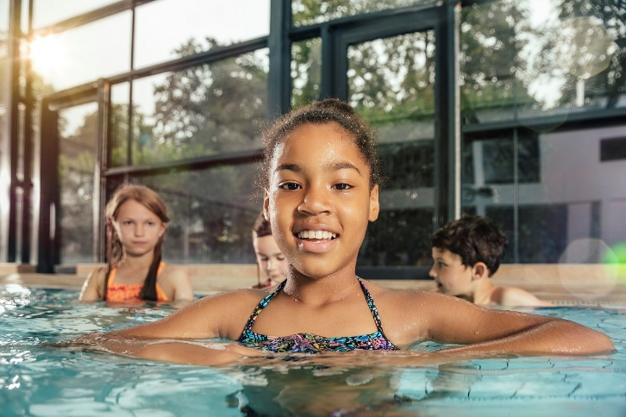
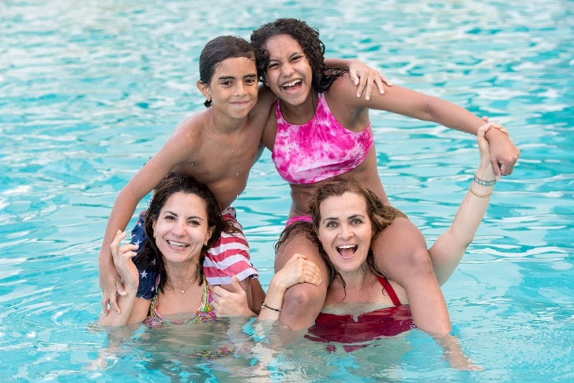
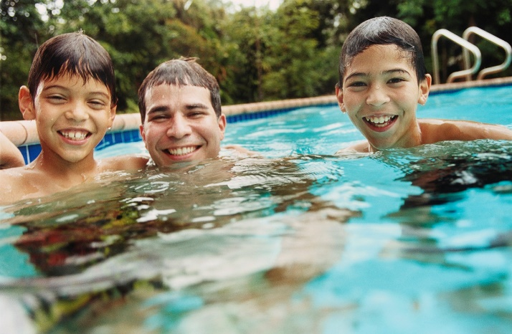

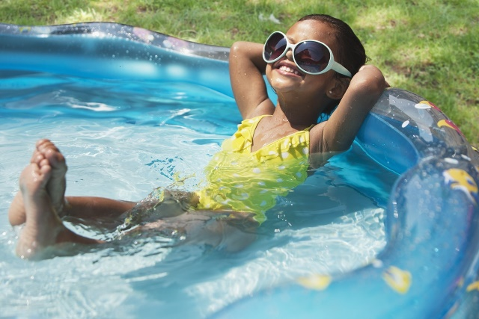
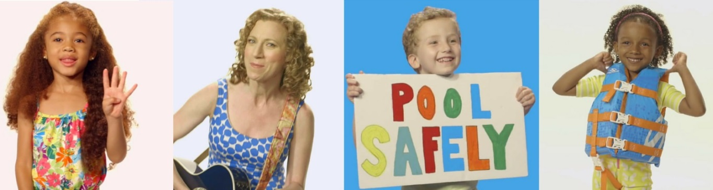

Slide 24
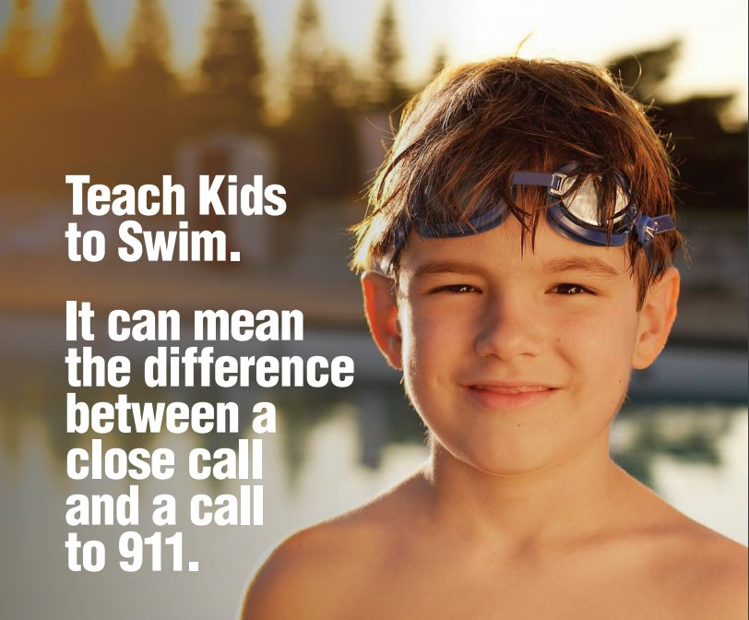
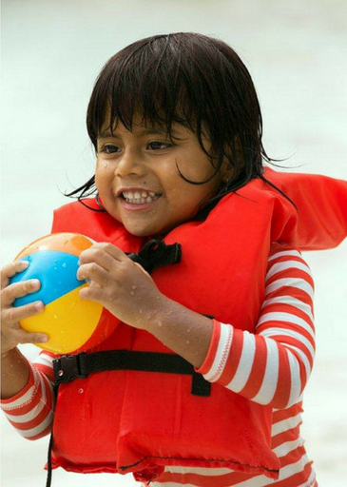
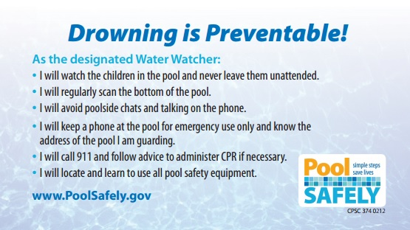

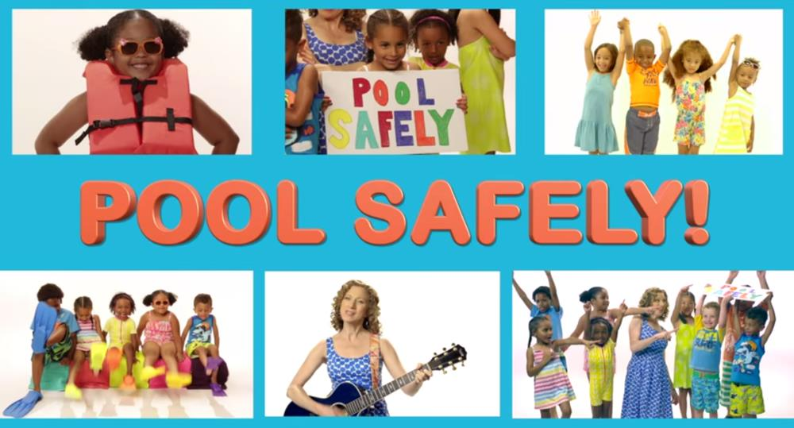
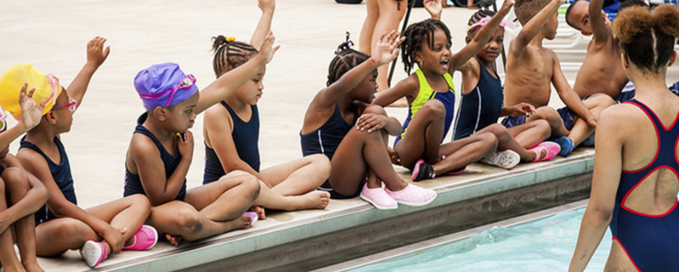
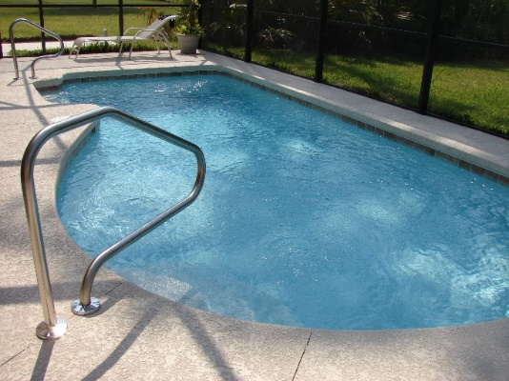
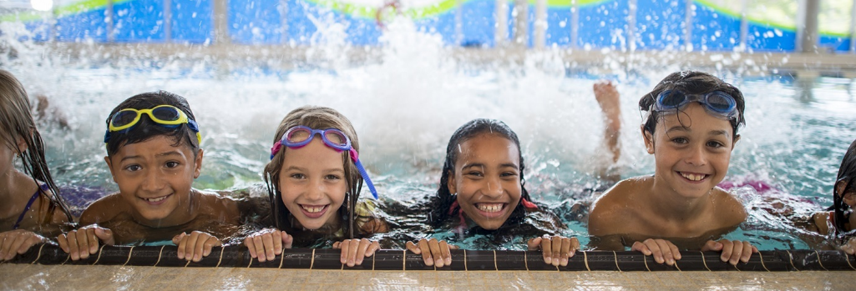

Slide 25
RESOURCES
Pool Safely Collaborator Toolkit

Slide 26

To watch and sing along to the Pool Safely song video by Laurie Berkner: http://bit.ly/LBPSsong
The Pool Safely Song

Slide 27

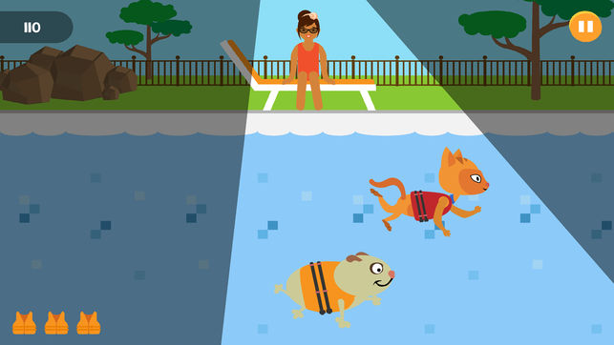
The Adventures of Splish & Splash
The Pool Safely app helps children learn about the dos and don’ts of water safety
To download the Pool Safely app on iPhone or Android: http://www.poolsafely.gov/parents/kids-corner/

Slide 28
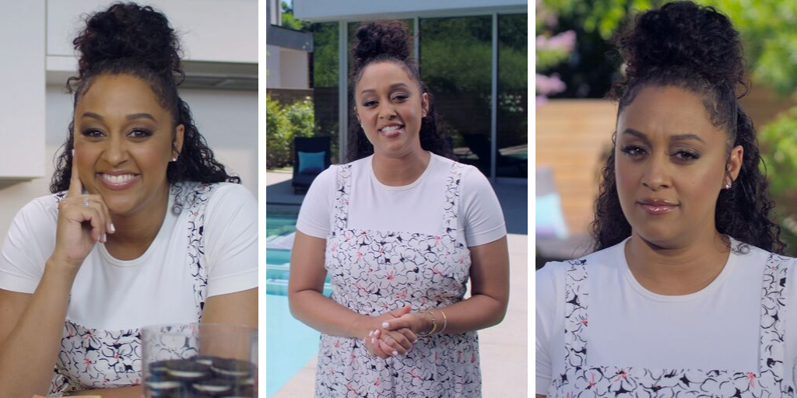
To watch a video featuring Tia Mowry sharing Pool Safely tips: https://www.poolsafely.gov/blog/behind-the-scenes-tia-mowry-urges-families-to-pool-safely-in-new-video/
Pool Safely Video with Tia Mowry

Slide 29
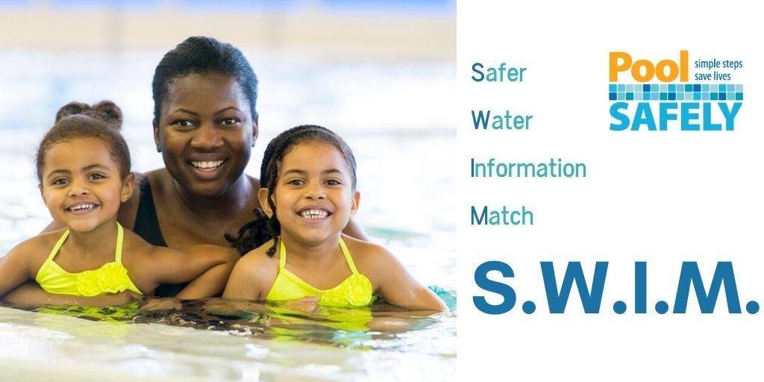
To get a list of customized water safety materials tailored to you: https://www.poolsafely.gov/blog/how-can-we-help-you-save-a-life-introducing-the-new-s-w-i-m-tool/
Safer Water Information Match (S.W.I.M.) Tool

Slide 30
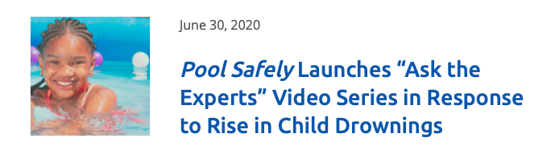


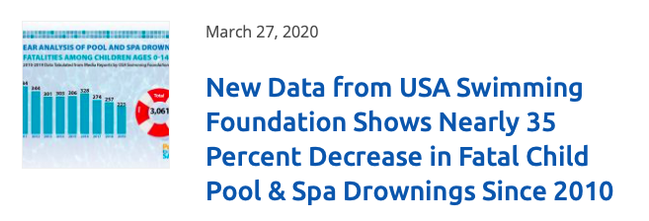
Pool Safely Blog
Check out the Pool Safely blog! https://www.poolsafely.gov/blog/
Learn practical water safety information and get a behind-the-scenes look at the Pool Safely campaign’s work over the years.

Slide 31

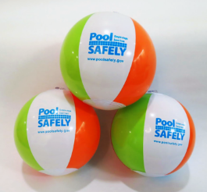
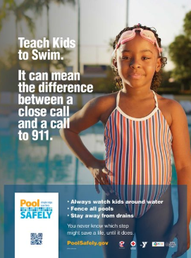

Materials Catalog
Download brochures, tip cards, posters, videos and more in English and Spanish through our online materials catalog: https://www.poolsafely.gov/educational-materials-catalog/

Slide 32
CONTACT INFORMATION
Pool Safely Collaborator Toolkit

Slide 33
Keep in touch with Pool Safely!
To follow Pool Safely on Twitter: https://twitter.com/poolsafely
To follow Pool Safely on Instagram: https://www.instagram.com/poolsafely/
To follow Pool Safely on Facebook: https://www.facebook.com/poolsafely/
To email us your questions, photos and information about your water safety events: poolsafely@cpsc.gov

